Slide 1

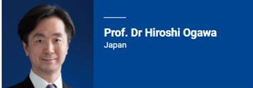
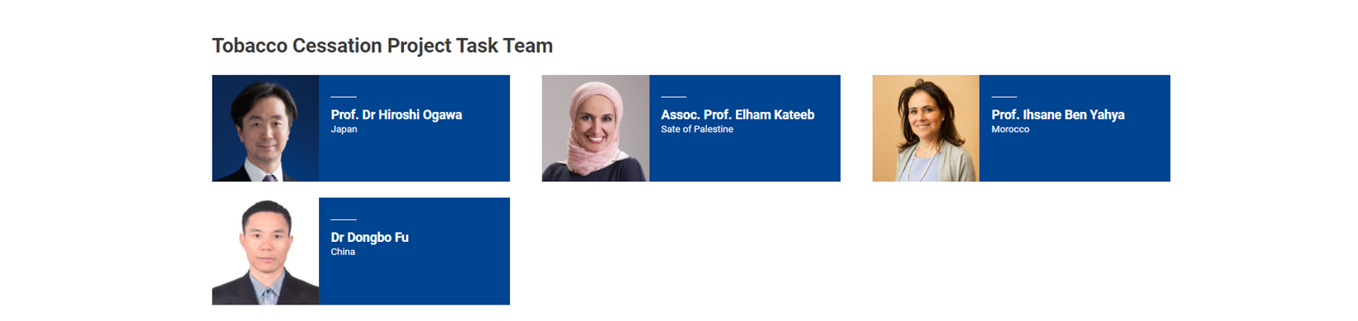
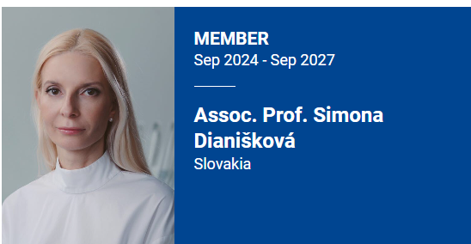
Experts Group
https://www.fdiworlddental.org/tobacco-cessation

Slide 2


The mission
FDI is advocating for oral health care teams to acknowledge that helping tobacco users to quit the habit is part of their role and to formally recognize that smoking cessation is part of the practice of dentistry.
In addition, oral health professional organizations should have a responsibility in supporting political processes to build an environment conducive to health and that includes strong tobacco control policies.

Slide 3

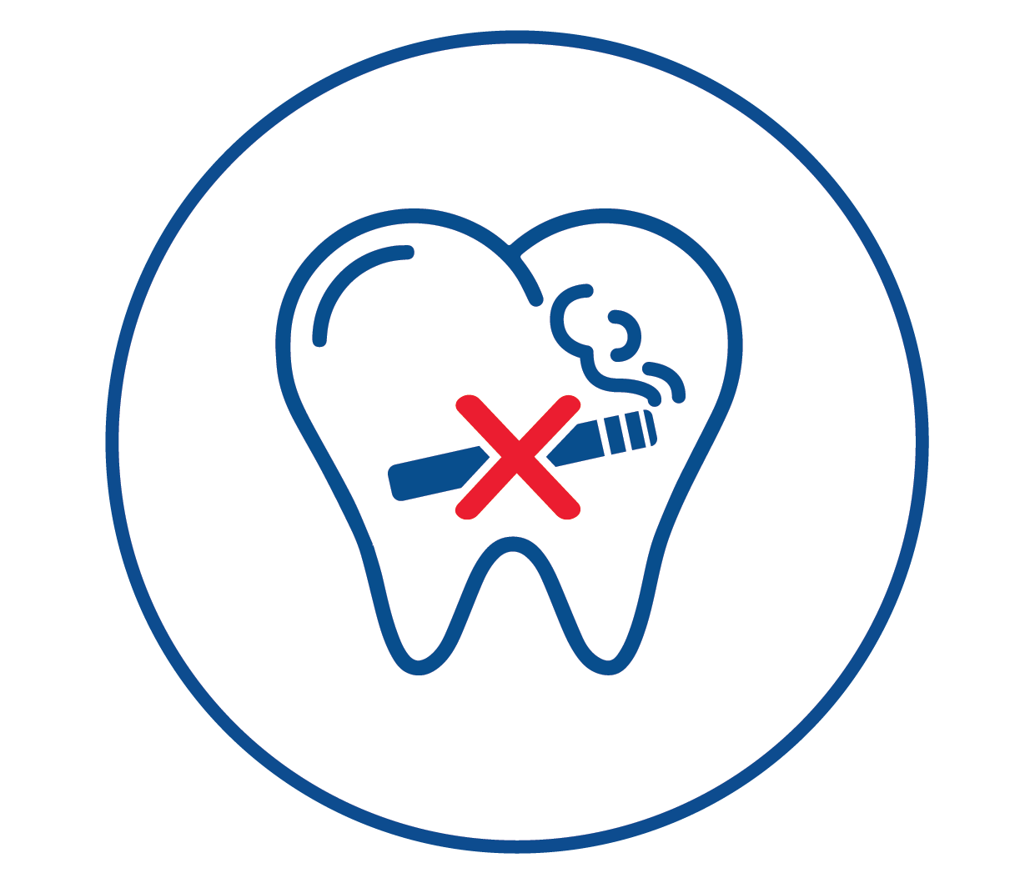
The FDI Tobacco Cessation project was launched in 2020 to provide oral health professionals with smoking cessation and control resources that can be implemented in the dental setting in collaboration with other relevant health professionals.

Slide 4
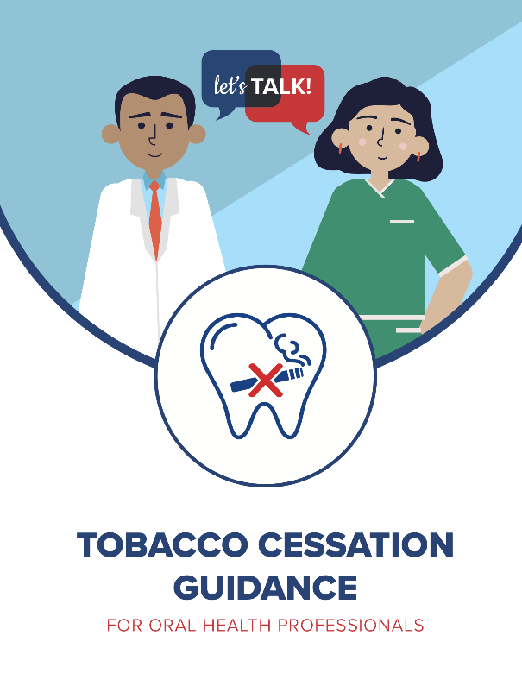
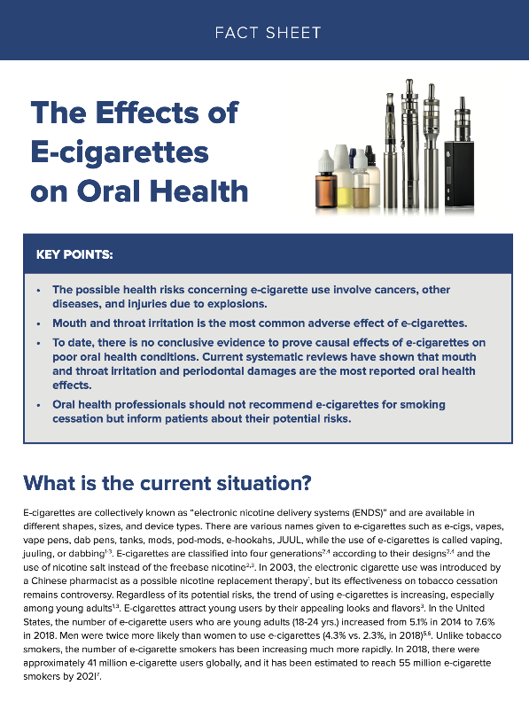
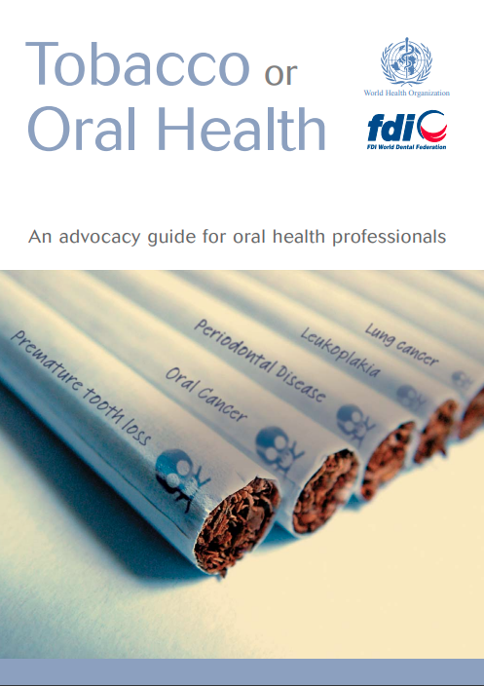
FDI Tobacco Cessation Guide for Health Professionals
The Effects of
E-cigarettes on Oral Health
Tobacco or
Oral Health
Chairside guide
This new guidance presents how to deliver a three to five minutes advice to help a tobacco user make a quit attemptin a primary care setting.
Chairside guide
Guide, developed jointly by FDI World Dental Federation (FDI) and the World Health Organization (WHO)

Slide 5


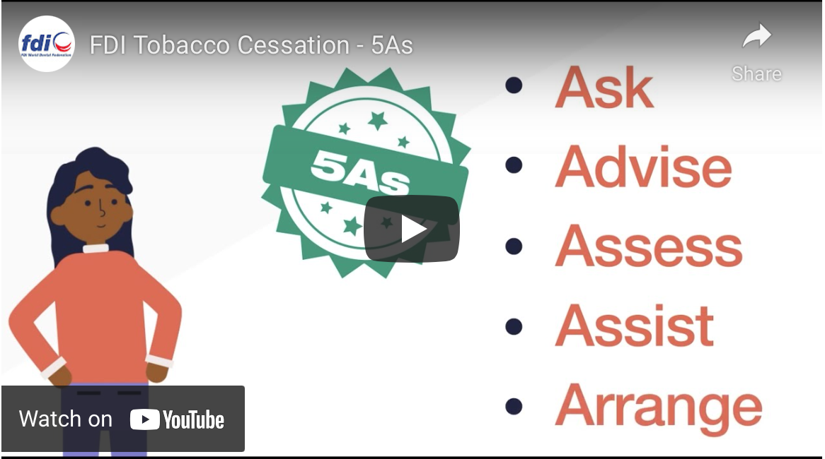
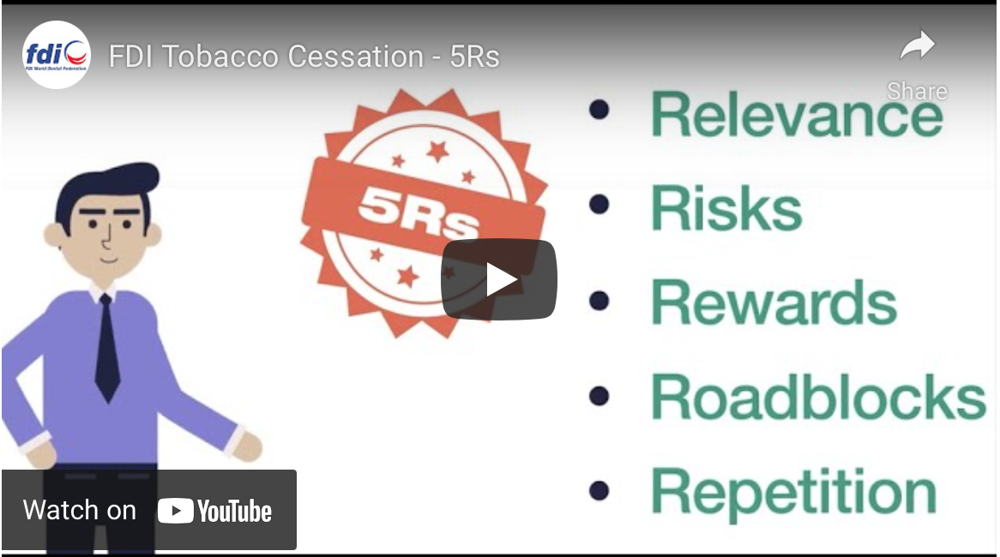

Watch how to deliver three-to-five-minute, brief tobacco interventions to dental patients
in primary care by using the 5As and 5Rs models:
Project Goals
Increase awareness of the fundamental role of oral health profession to work for tobacco cessation
Increase knowledge and skills of oral health professionals to provide tobacco cessation interventions in dental settings
Increase awareness of the dangers of tobacco smoking to oral health & emphasize the importance of oral health to achieving overall health and well-being.

Slide 6
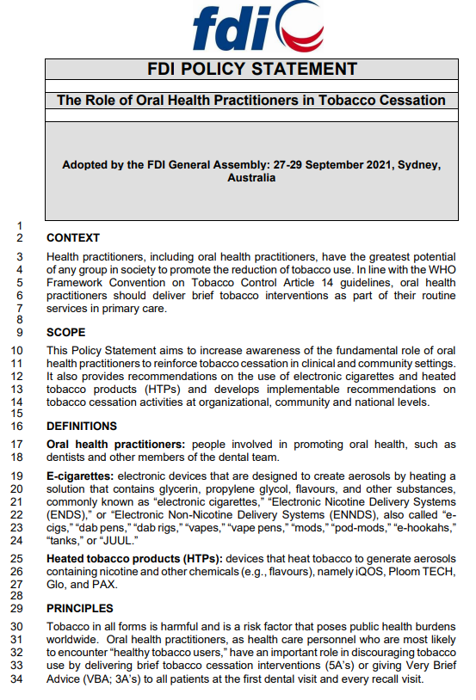
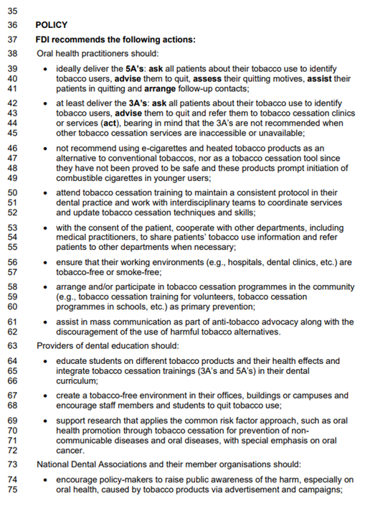
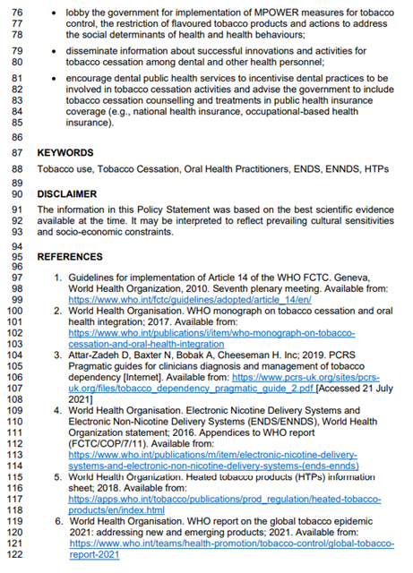
https://www.fdiworlddental.org/sites/default/files/2021-10/EN%20-%20FDPS_Tobacco%20PS.pdf

Slide 7

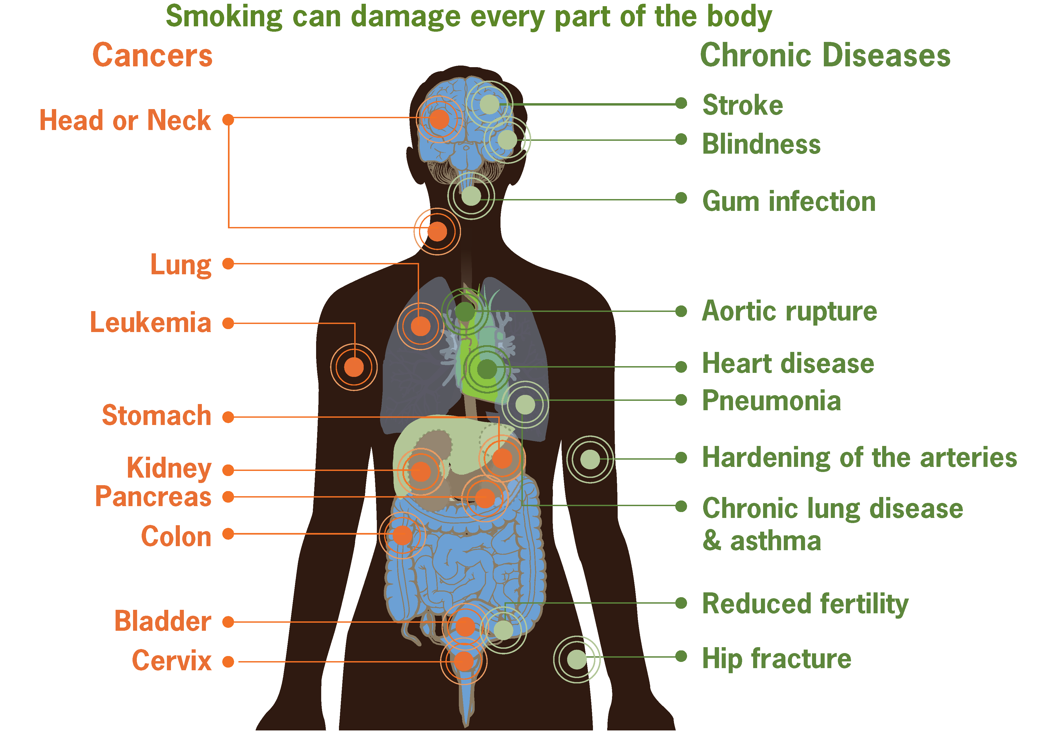
Risks from smoking

Slide 8
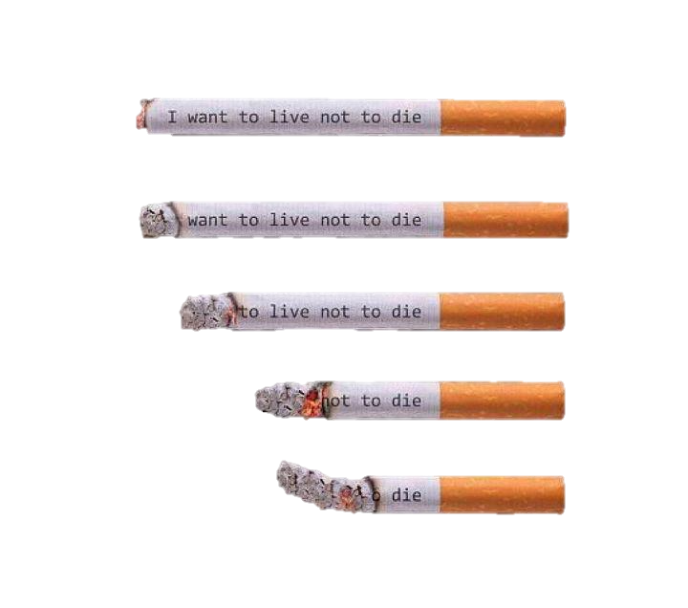
Each cigarette deprives you of
11 minutes of your life...
Longitudinal depiction
of tobacco products' health burden

Slide 9

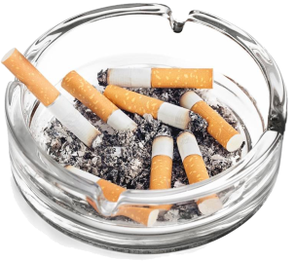
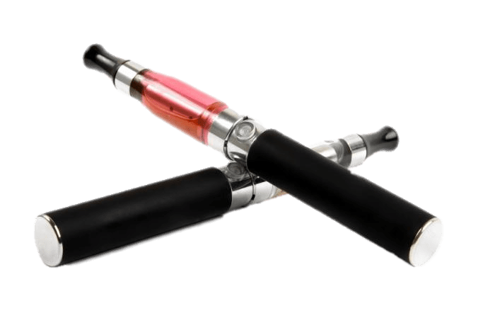
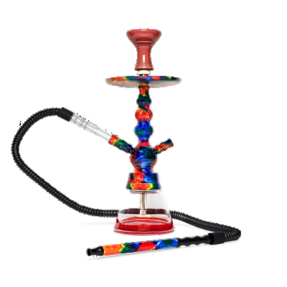

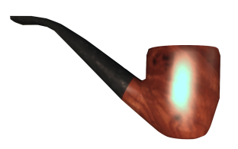
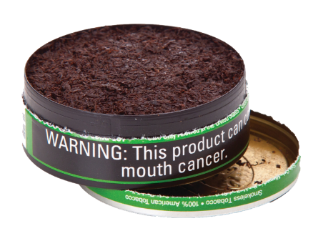
Tobacco products in different formats of use
Electronic cigarettes
(e-cigarettes)
Cigarettes
Cigars
Hookah
Pipes
Chewing Tobacco

Slide 10
Smoking behavior
Understanding SMOKING BEHAVIOR
The following factors reinforce smoking behavior:
Social, physical and psychological.
Smokers continue to smoke despite knowing the risks, due to the complex and addictive nature of the smoking habit.
Tobacco and tobacco products lead to both emotional and physical dependence.

Slide 11
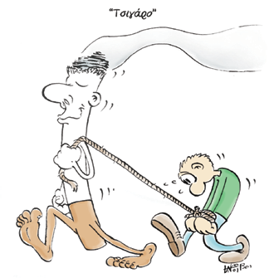
Addiction
The repeated and uncontrolled use of a substance is referred to as addiction.
Smoking addiction is primarily physical in nature, relying on the stimulation and functioning of brain centers.
Notes:
Τι είναι εξάρτηση;Ερωτήσεις προς μαθητές: Τι βλέπουμε στο σκίτσο; Πώς είναι το τσιγάρο σε σχέση με τον άνθρωπο; (μέγεθος, συναισθήματα κορμοστασιά) Πώς φαίνεται να είναι ο άνθρωπος;

Slide 12
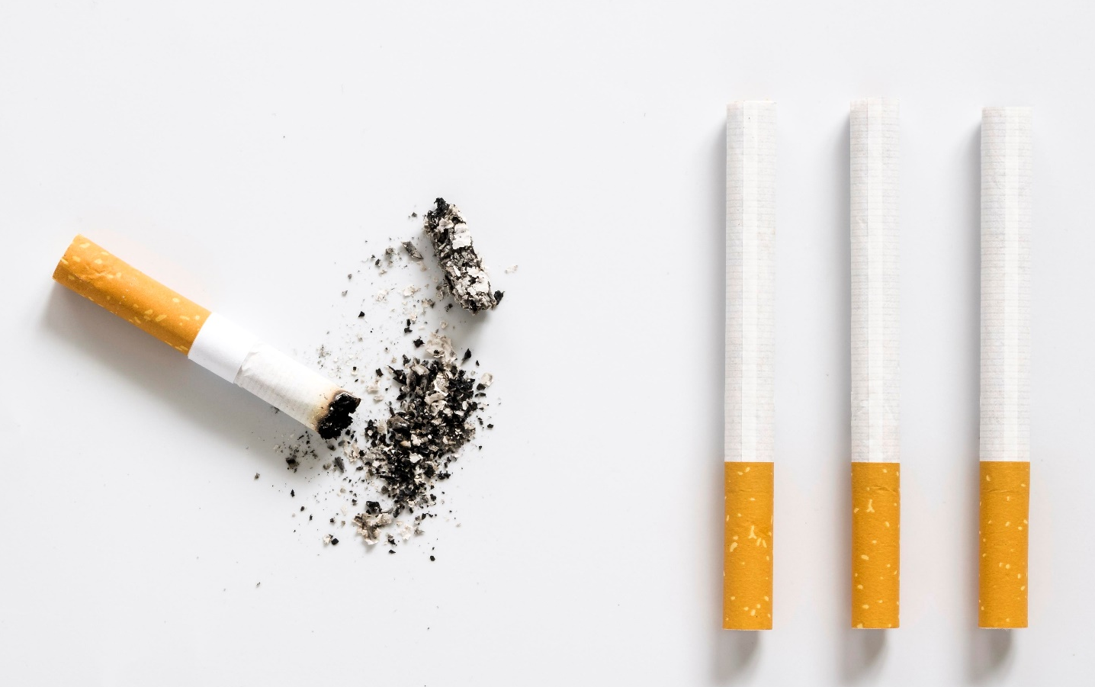
Automated habit
The smoker frequently lights the cigarette unconsciously while performing other activities such as drinking coffee, tea, or alcohol, driving, or at the end of a meal.

Slide 13
Physical addiction
Nicotine after inhalation reaches the brain in 8’’ and the body in 20’’.
01
They should smoke every 20-45 minutes, depending on the intensity of smoking, to maintain the level of nicotine in their blood avoiding feeling deprived.
02
Nicotine is excreted in the body within 24 hours, but it takes weeks for the body to reestablish its biochemical balance.
03

Slide 14

Psychological component
Emotional dependence is linked to the psychological component.
Smoke to cope with stress, aggression, or anger, as a break from routine, to relax, or to stimulate.

Slide 15
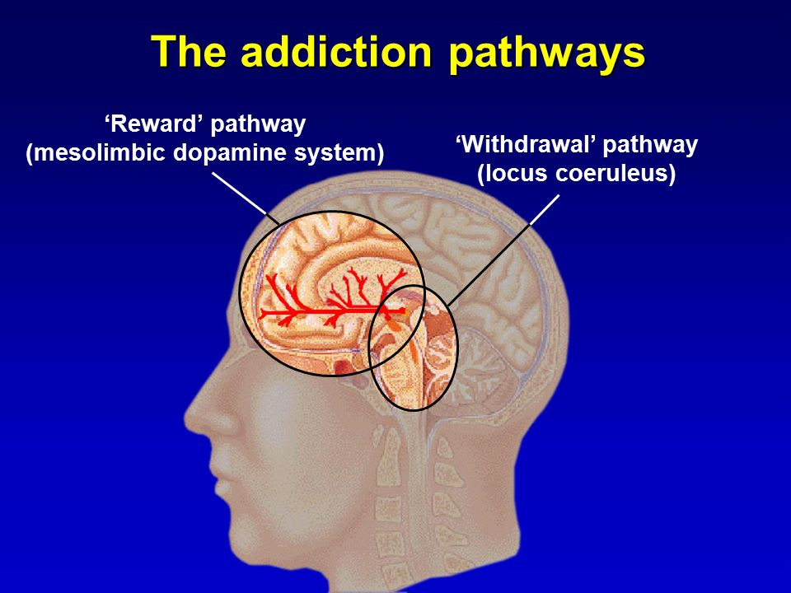
Addiction and its behavioral relationship to smoking
When the level of the addictive substance in the blood drops, the withdrawal center is activated, causing anxiety, nerves, and a strong desire to smoke the next cigarette. The smoker will then experience withdrawal symptoms.
When the level of the substance in the bloodstream returns to normal, the satisfaction center is stimulated, resulting in pleasure. Because it covers the withdrawal symptoms, he feels calm and relaxed.
Attention!!!! Cigarettes are not calming and relaxing, but they do mask the withdrawal symptoms caused by the cigarette.

Slide 16
Is quitting smoking an easy task?
70% WANT TO STOP
ALL SMOKERS
30% TRY EACH YEAR
2-3% SUCCEED IN STOPPING EACH YEAR

Slide 17
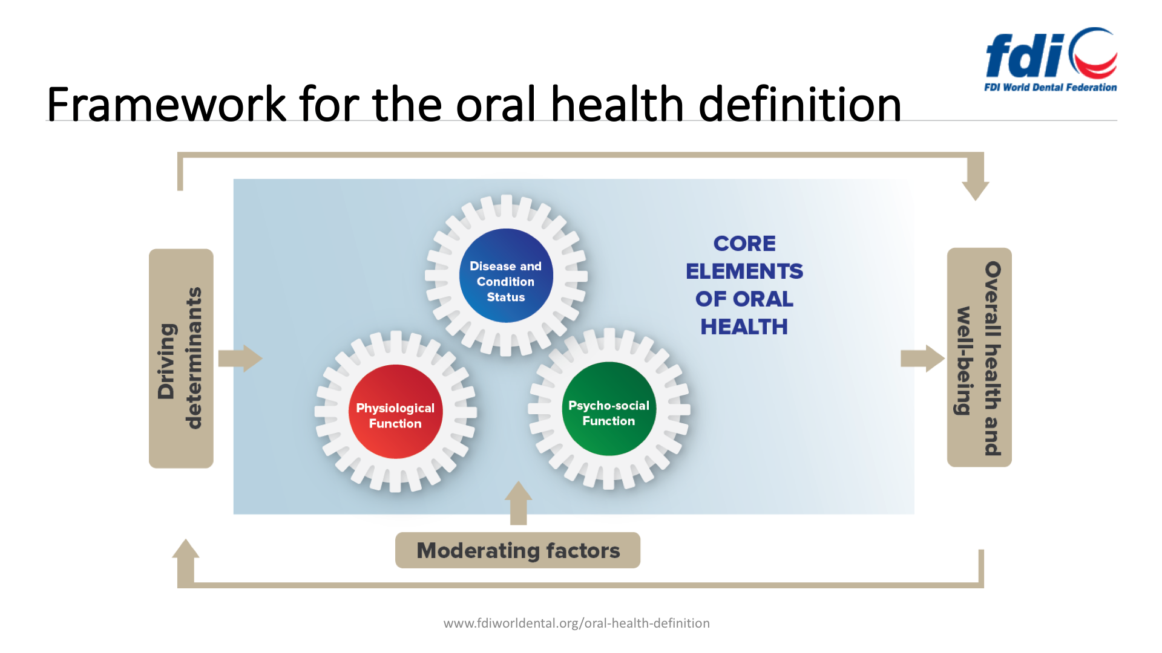
FDI’s definition of oral health
Oral health is multi-faceted and includes the ability to speak, smile, smell, taste, touch, chew, swallow and convey a range of emotions through facial expressions with confidence and without pain, discomfort and disease of the craniofacial complex (head, face, and oral cavity).
Oral health means the health of the mouth. It comprises a vital component to general health and well-being.
Source:.
Notes:
https://www.fdiworlddental.org/oral-health/fdi-definition-of-oral-health

Slide 18
Diseases and oral lesions related to smoking
Teeth staining
White lineation
Leukoplakia
Gingivitis - Periodontitis
Nicotine stomatitis
INNOCENT
Failure of dental implants
HAZARDOUS
Malodor
Cancer
Pigmentation
Hairy tongue
Dry mouth

Slide 19
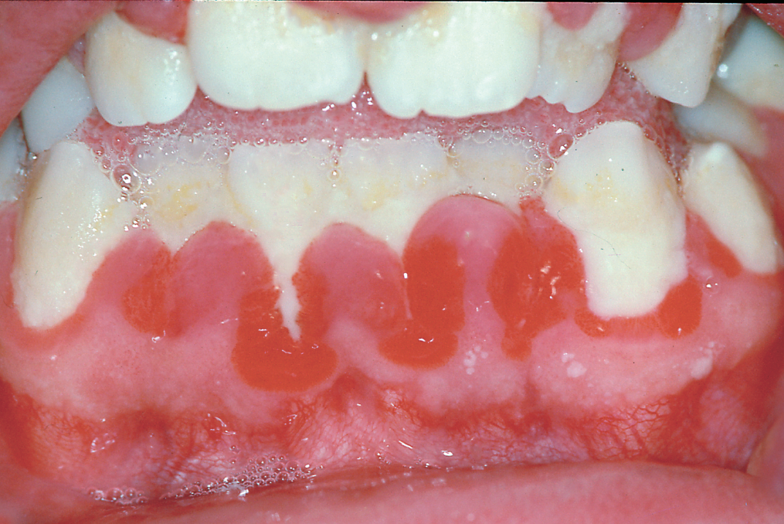
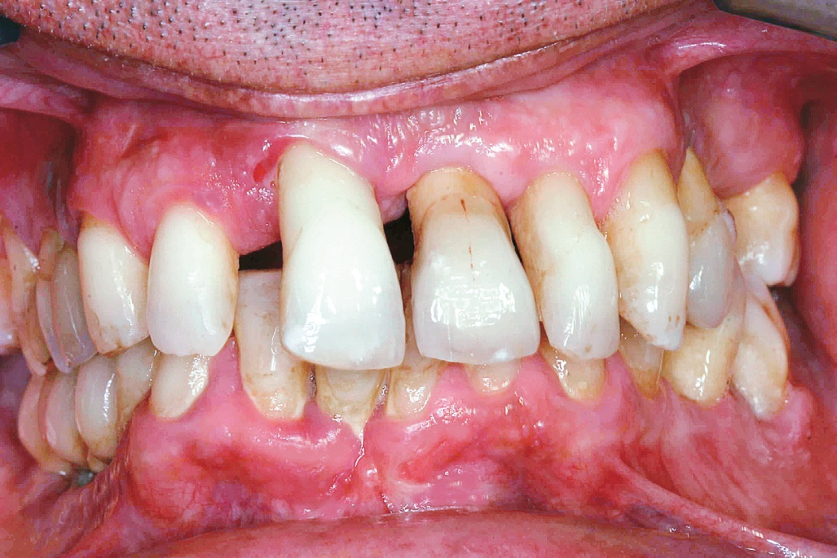

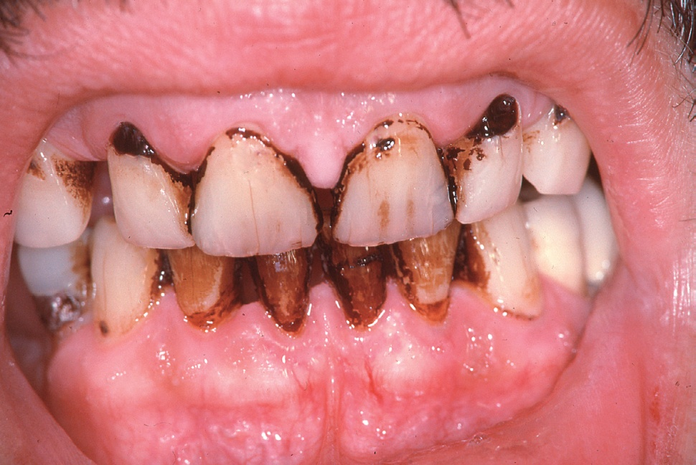
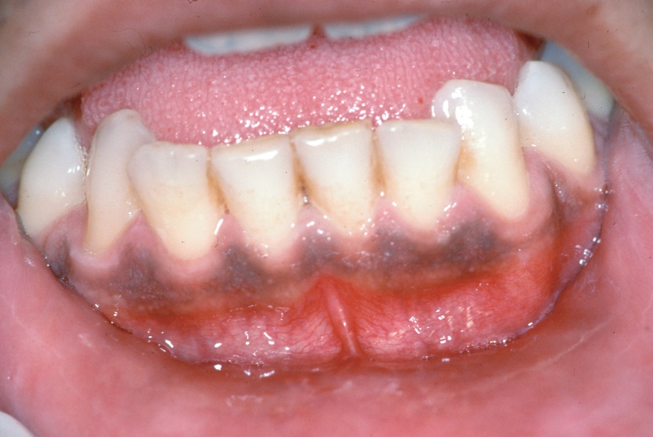
Gingivitis
Periodontitis
Teeth staining
Gingival Pigmentation

Slide 20
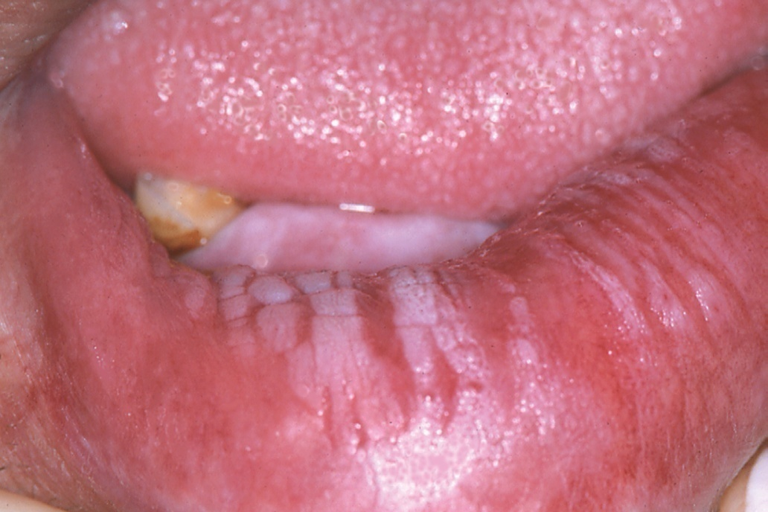
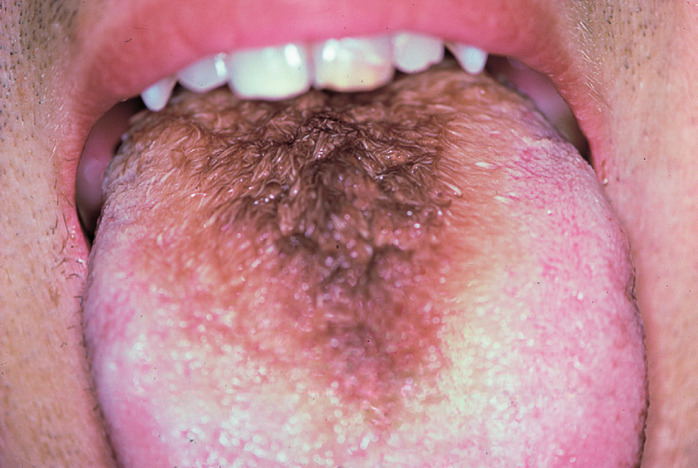
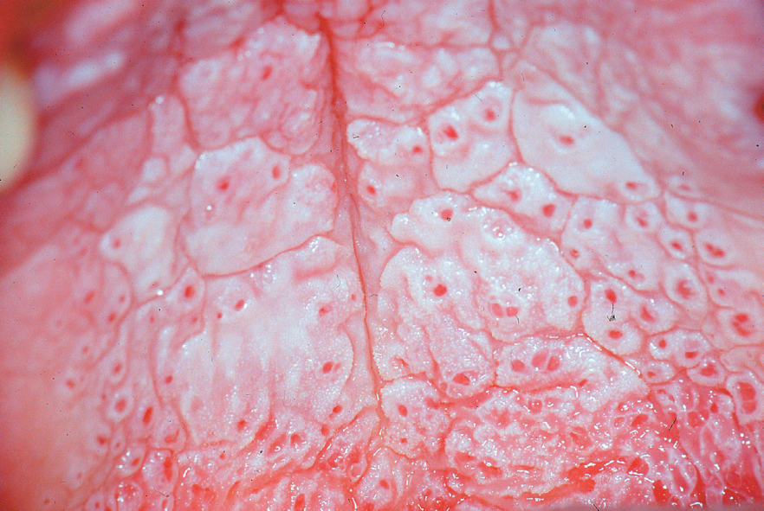
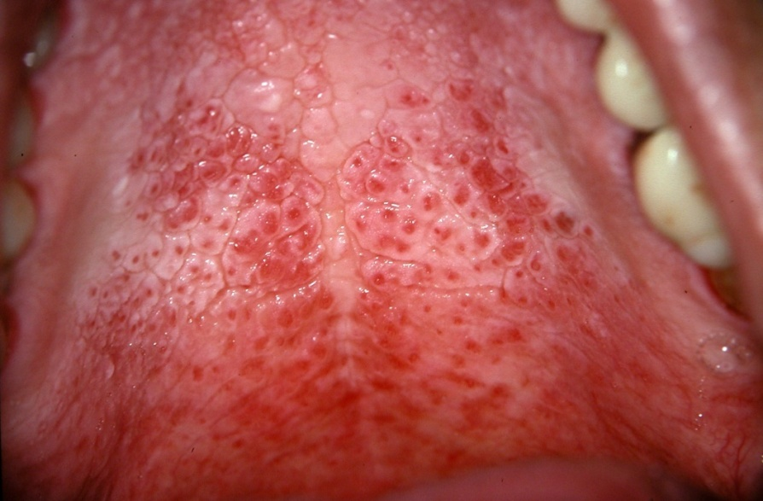
White lineation
Hairy tongue
Nicotine stomatitis
Nicotine stomatitis

Slide 21
Leukoplakia
It is the most common type of precancerous lesion* in the mouth (95%)
High frequency in adults (4%)
90% of patients are smokers
5-6% of these cases develop into cancer
* A precancerous lesion is morphologically altered tissue that is more likely to become cancerous than normal tissue.

Slide 22
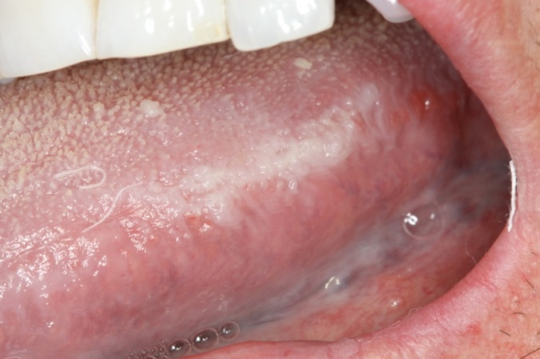
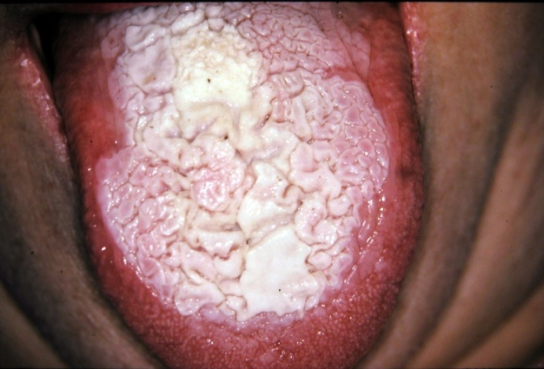
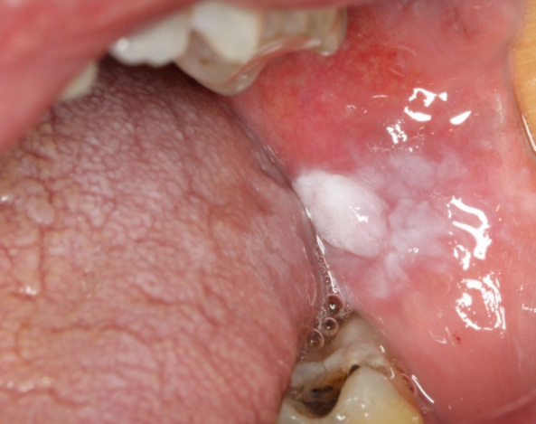
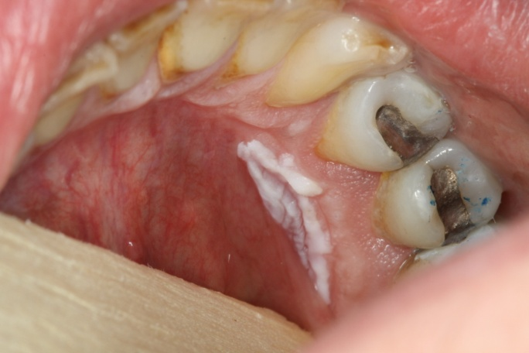
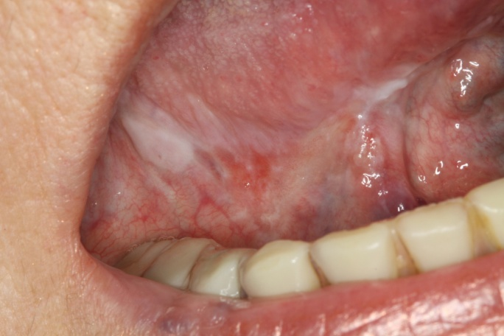
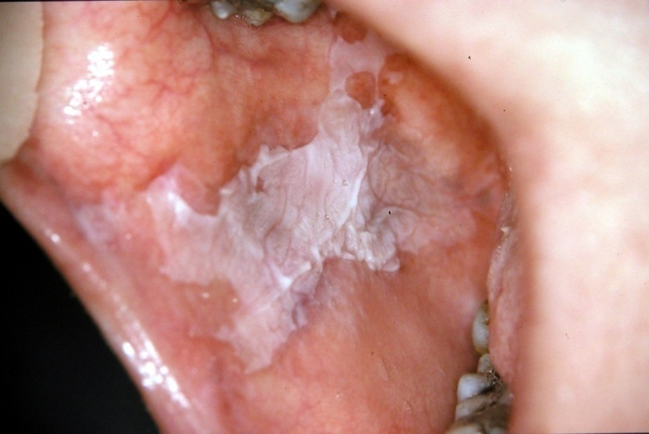
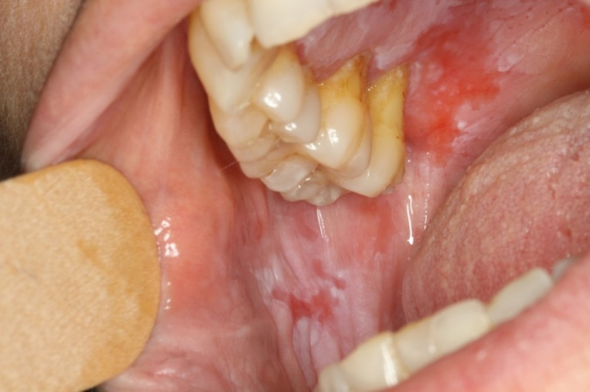
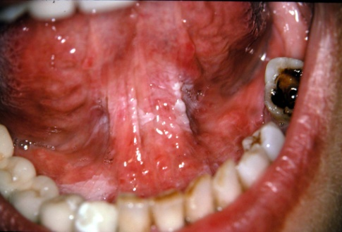
LEUKOPLAKIA
(PRECANCEROUS LESIONS)

Slide 23
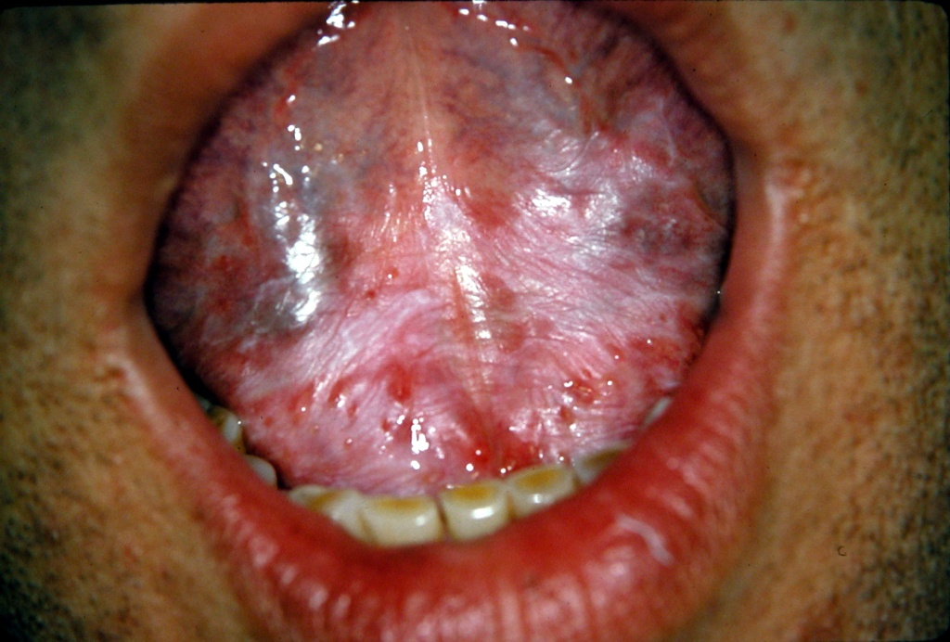
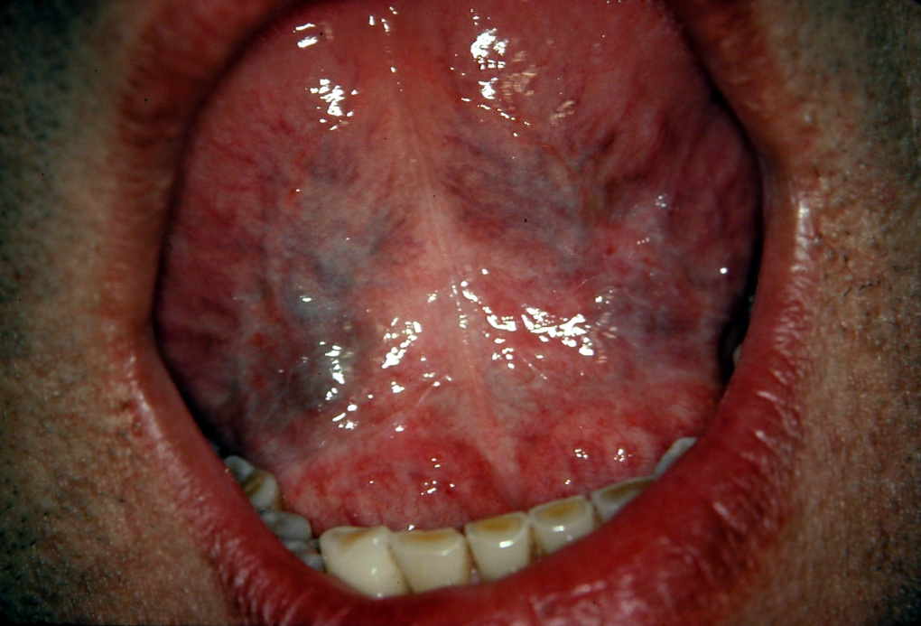
Complete remission of the lesion 2 months after smoking cessation
A heavy smoker's leukoplakia

Slide 24
ORAL CANCER
AND
SMOKING

Slide 25

Oral Cancer KILLS as many people as melanoma, and is now more common than leukemia.

Slide 26
Oral cancer Epidemiology
It is the 6th most common cancer worldwide
Men : Women = 2:1
Average age : 40-50years
Squamous cell carcinoma (SCC) is the most common type of oral cancer (90-95% of cases) and is strongly linked to smoking
Globally, there are 650,000 new cases per year and 300,000 deaths, with approximately one person dying every hour, 24 hours a day (annually we have 3-11 new cases per 100,000)
Oral cancer diagnosis is late. It is estimated that 55% of patients are diagnosed after metastases have occurred
Early diagnosis has a 5-year survival rate of more than 90%, whereas late diagnosis has a 5-year survival rate of only 50%.
Notes:
Action has to be taken to have an early diagnosis

Slide 27
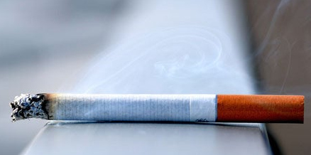

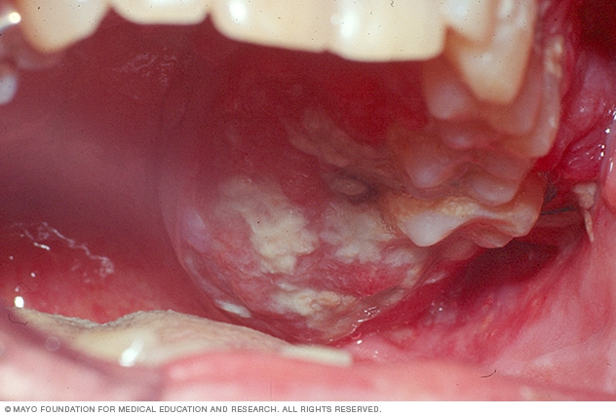

SMOKING and
The ORAL CANCER
Are almost like The MAN and his SHADOW:
inextricably LINKED

Slide 28
Smoking's role in oral cancer
Smokers have a 3.43 times greater risk of developing oral cancer than nonsmokers
(for lung cancer, the risk is 2.67 when smoking 20 cigarettes per day and 13.7 when smoking 20-40 cigarettes per day)
Oral cancer is caused by a series of molecular mutations in genes and chromosomes of cells, which are primarily caused by carcinogens in cigarettes
Notes:
1 cigarette contains 7000 harmful chemicals, 70 carcinogens

Slide 29
Oral cancer and quitting smoking
Quitting Smoking lowers the risk of oral cancer
The risk is comparable to that of a non-smoker ten years after quitting (if before middle age) (0.5%)

Slide 30
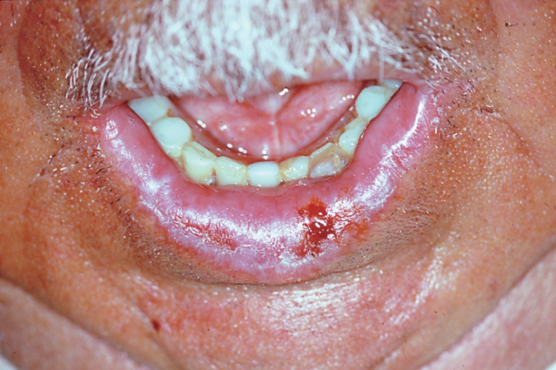
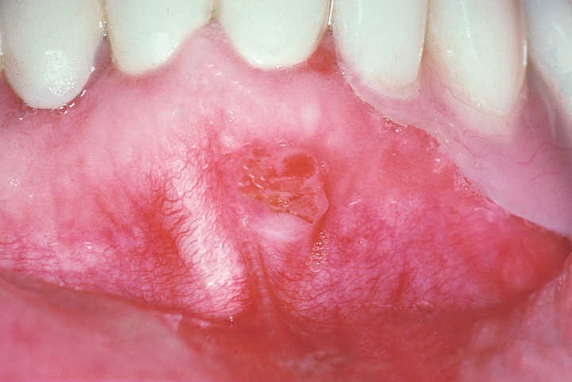
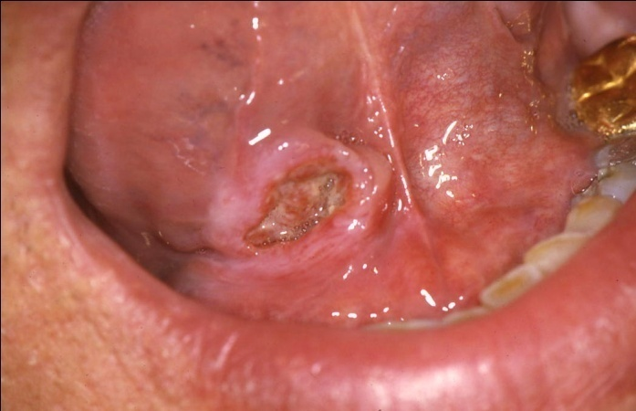
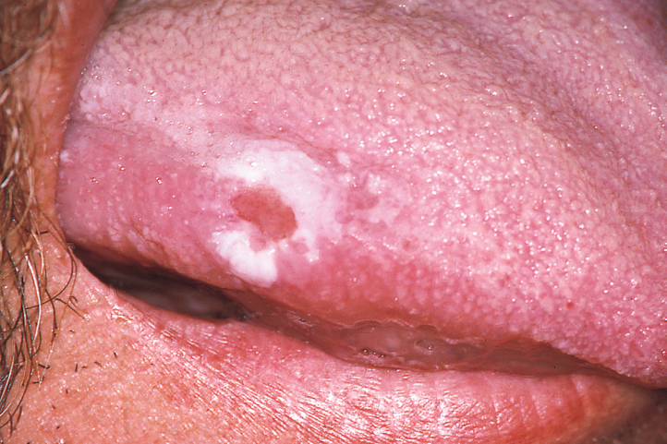
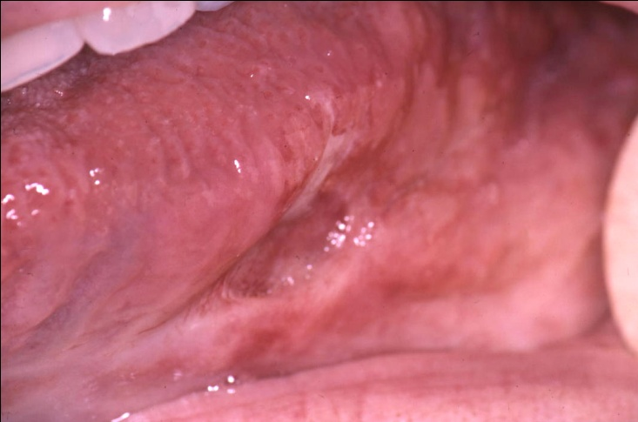
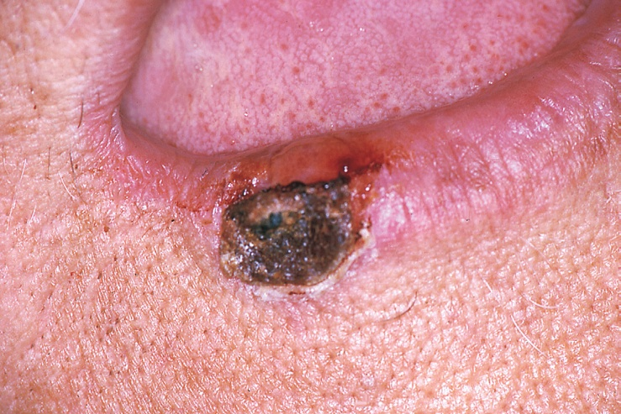
ORAL CANCER EARLY STAGE

Slide 31
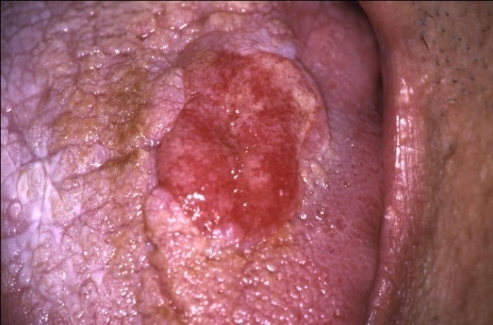





LATE STAGE - METASTASES

Slide 32

Diseases and oral lesions
related to e-cigarettes
Hairy tongue
Allergic reactions
Dry mouth
Gingivitis/Periodontitis
Intraoral burns, luxation injuries due to electronic cigarette explosions
Oral cancer
--------------------------------------------------------- Large proportion of e-cigarette/ vaping users also use conventional tobacco
Data are limited on the associated health hazards of e-cigarette use, particularly long-term effects. Research evidence of hazardous effects comparable to conventional smoking

Slide 33

Diseases and oral lesions
related to hookah
The user of a hookah inhales not only the tobacco combustion products, but also the chemicals generated by the burning charcoal.
It has the same health effects as cigarettes.
Because participants share the mouthpiece and pipe system of the same instrument, hookah use is linked to the spread of infectious diseases.
People who use hookahs are exposed to dangerously high amounts of passive exposure due to incomplete tobacco and charcoal combustion.

Slide 34

Tobacco Chewing (Areca/betel nut, betel quid, paan masala, snus/nass/snuff)
Oral Submucous Fibrosis
Leukoplakia
Lichen Planus
Squamous cell carcinoma
Tobacco Pouch Keratosis

Slide 35
Quitting smoking is the best thing a smoker can do for their health.
Benefits
Smoking Cessation Social Benefits
When people quit, they frequently express a strong sense of pride.
Most public and workplaces are now smoke-free, being a smoker can create additional barriers to socializing, while quitting allows you to feel more at ease in social situations.
According to research, ex-smokers have less stress and anxiety three to six months after quitting. Smokers experience more stress because they are constantly dealing with the anxiety caused by cravings.
When you quit smoking, your children become less likely to start smoking and more likely to quit if they already smoke.
Smoking Cessation Economic Benefits
If you stop smoking, you will have more money. With cigarette prices averaging around $20 per packet, you could save $7,300 per year. If you saved at this rate for five years, you would save approximately $36,500.
In some low-income countries, poor households spend 10% to 15% of their income on tobacco.
Source:. Queensland Health

Slide 36


Benefits of quitting smoking
If you don't smoke:
• improved oral treatment outcomes;
• food will taste better;
• improved sense of smell;
• saving money;
• feeling better about oneself;
• home, car, clothing and breath will smell better;
• setting a good example for children and decreasing the likelihood that they will smoke;
• having healthier babies and children;
• feeling better physically;
• performing better in physical activities.
A pack of cigarettes per day costs:
After 3 months, a pack of cigarettes costs the same
as a computer.
After 1 year, the cost of a trip abroad is comparable.
After 10 years, it costs the same as a car.
After 30 years, it's the same as buying a house.
Source:. http://tobaccobody.fi

Slide 37

Oral Physicians
Physicians
Nurses
Researchers
Midwives
Community Health Workers
Dental Hygienist
Behaviorists
Dental / Medical Assistants
Educators
Pharmacists
Dentists
Dental Therapists

Slide 38
Brief tobacco interventions
(5As and 5Rs)

Slide 39
Brief tobacco interventions
(5As and 5Rs)
Workshop overview

Slide 40

Aim of training
deliver brief tobacco interventions as part of oral health and dental practice
To increase your knowledge, skills and confidence to:

Slide 41
Objectives
1.Describe the 5A’s and 5R’s brief tobacco intervention models
2. Deliver brief tobacco interventions as part of your routine practice according to a "5A's" Model and a "5R's" Model:
  - Ask patients about their tobacco use and advise them to quit in an appropriate way
  - Use two ways to assess patients’ readiness to quit
  - Respond appropriately in cases of low motivation to quit, employing the 5R’s model
  - Assist patients to stop tobacco use by helping them with a quit plan and arrange follow-up contacts

Slide 42
Overview of 5A’s model

Slide 43

Unique role of oral health professionals in tobacco control and tobacco cessation

Slide 44
Behavioral interventions:
  Population-level approaches:
    Brief advice
    Telephone counseling (quit lines)
    Tobacco cessation
  Individual specialist approaches
    Intensive behavioral counseling
    Cessation clinics
Pharmacological interventions:
  Nicotine replacement therapy (NRT)
  Bupropion
  Varenicline
  Cytisine
Effective tobacco cessation interventions

Slide 45
What tobacco cessation interventions should oral health professionals deliver in primary care?
-Oral health professionals should routinely offer brief tobacco interventions to all tobacco users in primary care.
- Brief intervention (also called brief advice): Advice to stop using tobacco, usually taking only a few minutes, given to all tobacco users, usually during the course of a routine consultation or interaction.
Source: WHO FCTC Article 14 Guidelines.

Slide 46
Health care providers can help patients quit tobacco use by offering interventions as short as 3 minutes
Level of contact | Number of arms | Estimated odds ratio (95% C.I.) | Estimated abstinence rate (95% C.I.)
No contact | 30 | 1.0 | 10.9
Minimal counseling (< 3 minutes) | 19 | 1.3 (1.01, 1.6) | 13.4 (10.9, 16.1)
Low intensity counseling (3-10 minutes) | 16 | 1.6 (1.2, 2.0) | 16.0 (12.8, 19.2)
Higher intensity counseling (> 10 minutes) | 55 | 2.3 (2.0, 2.7) | 22.1 (19.4, 24.7)
Source: Fiore MC et al. Treating tobacco use and dependence: 2008 update.

Slide 47

Algorithm for delivering brief tobacco interventions

Slide 48


Effective delivery models
5A's for patients who are ready to quit
5R's for patients not ready to quit

Slide 49

ASK
Ask about tobacco use at EVERY encounter.
Keep it simple:
  Do you use tobacco?
  Does anyone else smoke around you?
For health facilities: to include tobacco use as a “vital sign”
  Tobacco use (circle one): Current Former Never

Slide 50
ASK
Ask about tobacco use at EVERY encounter.
Keep it simple:
  Do you use tobacco?
  Does anyone else smoke around you?
For health facilities: to include tobacco use as a “vital sign”
  Tobacco use (circle one): Current Former Never

Slide 51
Advise to Quit
Advise to quit in clear, strong and personalised manner!
Clear—“I would suggest you quit smoking (or using chewing tobacco) now, and I can help you.”
Strong—“As your clinician, I need you to know that quitting smoking is the most important thing you can do to protect your health now and in the future. The clinic staff and I will help you.”
Personalized—Tie tobacco use to demographics, health concerns and social factors.

Slide 52
Examples of personalized Advice
Demographics: For example, women may be more likely to be interested in the effects of smoking on fertility than men.
Health: Those with gum disease may be interested in the effects of smoking on oral health.
Social Factors: People with young children may be motivated by information on the effects of second hand smoke, while a person struggling with money may want to consider the financial costs of smoking.
Evidence shows that providing tailored information on smoking is more effective than providing standardised information.
Source: Lancaster & Stead , 2005

Slide 53
Tailoring Advice
In a brief intervention:
  There are a number of factors that a practitioner may think about when give personalized advice
  It would be impossible to tell patients about every possible effect of tobacco use
When how to tailor advice for a particular patient is not obvious, a useful strategy may be to ask the patient:
  “What do you not like about being a smoker?”
  The patient’s answer to this question can be built upon by the practitioner with more detailed information on the issue raised…

Slide 54
Tailoring Advice
Example:
Doctor: “What do you not like about being a smoker?”
Patient: “I suppose I don’t like the way it makes me cough”
Doctor: “Yes. Smoking does effect lung function, and it will get worse over time if you continue to smoke.”
Example:
Doctor: “What do you not like about being a smoker?”
Patient: “Well, I don’t like how much I spend on tobacco.”
Doctor: “Yes, it does build up. Let’s work out how much you spend each month. Then we can think about what you could buy instead!”

Slide 55
Assessing Readiness to Quit
If a tobacco user believes "quitting is important" and has high level of confidence (self-efficacy) in their ability to quit, he or she is more likely to say:
  “I want to be a non- tobacco user” (a desire to be non-tobacco user)
  “I have a chance of quitting successfully” (high level of confidence in his or her ability to quit)

Slide 56
Assessing Readiness to Quit
Method 1: asking two questions related to importance and self-efficacy:
  “Would you like to be a non-tobacco user?”
  “Do you think you have a chance of quitting successfully?”
  In relation to the first question – someone needs to be quite sure that they want to be a non-tobacco user. Only a ‘Yes’ will do!
  In relation to the second question– there is room for some doubt. It is OK to be unsure – but a definite ‘No’ indicates a problem.

Slide 57

Assessing Readiness to Quit
Any answer in the RED area indicates that the smoker is NOT ready to quit.
In these cases we should deliver the 5R’s intervention.

Slide 58
Assessing Readiness to Quit
Method 2: asking just one question:
  “Would you like to quit tobacco within the next 30 days?”
  If the answer is "No" indciates that the tobacco user is NOT ready to quit and we should deliver the 5R's intervention.

Slide 59
Assist
For the patient willing to quit, the following actions
can be taken to aid the patient in quitting
Help develop a quit plan
Provide practical counseling
Provide intra-treatment social support
Help patient obtain extra-treatment social support
Recommend pharmacotherapy if appropriate
Provide supplementary materials
Source: Fiore MC et al. Treating tobacco use and dependence, 2008

Slide 60

Developing a quit plan-STAR

Slide 61
Arrange
When - timing is everything!
  The majority of relapse occurs in the first two weeks after quitting
  First contact - within one week after the quit date
  Second - within the first month
How - use practical methods
  Telephone
  Personal visit
  Mail/ E-mail
What - actions during follow up contacts

Slide 62
Actions during follow-up contact
For all patients | Identify problems already encountered and anticipate challenges Remind patients of available extra-treatment social support Assess medication use and problems Schedule next follow-up contact
For patients who are abstinent | Congratulate them on their success
For patients who has used tobacco again | Remind them to view relapse as a learning experience Review circumstances and elicit recommitment Link to more intensive treatment if available

Slide 63
Arrange
Ask
The 5As (Ask, Advise, Assess, Assist, Arrange) summarize all the activities that a primary care provider can do to help a tobacco user within 3 to 5 minutes in primary care settings
You can start and stop at any step as indicated in the diagram
Arrange
Advise
Quit plan and follow-up plan
Assist
Assess

Slide 64
Role play 1 (40 minutes): the 5A’s intervention
  Please volunteer to role-play a 5A’s brief tobacco intervention in small groups (in breakout rooms):
  Scenario 1:James
  Scenario 2: Betty

Slide 65
Overview of 5R’s model

Slide 66
Patients not Ready to Quit?
Often, the patient will not be ready to quit. They may not want to be a non-tobacco user, or be certain that they could not quit.
In these cases we will deliver a brief motivational intervention before ending the consultation. The intervention is called the 5R’s
This will occur after the Assess stage. Once completed we can re-assess readiness to quit and complete the 5A’s if appropriate)…

Slide 67

Patients not Ready to Quit?
Not Ready to Quit
Five R’s
Ready to Quit
Not Ready to Quit
End positively

Slide 68
Overview of 5Rs model
The 5R’s model is a brief motivational intervention that is based on principles of Motivational Interviewing (MI).
MI stems from working with people who had problems with drinking alcohol.
1980's-William Miller, PhD & Stephen Rollnick, PhD
Definition:
  A directive, patient-centered counseling style that enhance motivation for change by helping patients clarify and resolve ambivalence about behavior change.

Slide 69
Overview of 5Rs model
Principles of MI are:
  Express empathy
  Develop discrepancy
  Roll with resistance
  Support self-efficacy
Goal of MI:
  To increase the person's intrinsic motivation based on the person's own personal goals and values.
  For tobacco users, it is aimed at making them more ready to quit. This may be because:
    they do not want to be a non-tobacco user, or
    they feel that they do not have a chance of quitting successfully.

Slide 70
How do you express empathy?
Understanding without judging, criticizing or blaming
“What might happen if you quit?”
Willingness to accept “where” a patient is (his/her place of readiness)
“I hear you saying you are not ready to quit smoking right now. I'm here to help when you are ready.”
A desire to understand the patient’s perspectives (does not mean that you agree)
“So you think smoking helps you maintain your weight.”

Slide 71
How do you develop discrepancy?
Discrepancy
  - Change is motivated by a perceived discrepancy between present behaviours and personal goals or values
  - Use strategies to assist patient in identifying discrepancy and move forward change

Slide 72
How do you develop discrepancy?
Put aside the "how to do it", ask patients about their vision/goal
  Let’s put aside the “how to do it”, for right now, and just talk about what are some of the goals or values you hold?
  Patient: “I want to be a good role model for my children”
  Doctor: " How does smoking fit in with this goal"

Slide 73
Rolling with resistance
Resistance is an interpersonal phenomenon
  How we respond matters
"Yeah, but…" syndrome
  I can't afford the medications
  I am afraid I will gain weight.
  I don't smoke nearly as much as some other people that I know

Slide 74
Rolling with resistance
Causes
  Misjudge readiness/
  jumping ahead
  Arguing/lecturing
  Taking away control
Strategies
  Re-assess readiness
  Reflective listening
  Emphasize personal choice and control

Slide 75
Support self-efficacy
What we can do:
  Actual practice of quitting
  Observation of modeled behaviors
  Encouragement, convince them success is result of self
    “I have tried sixteen times to quit smoking.”
    “Wow, you’ve already showed your commitment to trying to stop smoking several times. That’s great! More importantly you’re willing to try again”
  Relaxation techniques, minimize stress and elevate mood
People develop self-efficacy
from four main sources:
  Mastery experience
  Observation of others' performance
  Verbal/social persuasion
  Emotional and Physiological arousal

Slide 76

Overview of the Five R’s
How is quitting most personally relevant to you?
What do you know about the risks of tobacco use in that regard?
What would be the benefits of quitting in that regard?
What would be difficult about quitting for you?
Repeat assessment of readiness to quit –
if still not ready to quit repeat intervention at a later date.

Slide 77
Example of the Five R’s
“How is quitting most personally relevant to you?”
“I suppose smoking is bad for my health.”

Slide 78
Example of the Five R’s
“What do you know about the risks of smoking to your health. What particularly worries you?”
“I know it could make dental implant treatment less successful. That must be awful.”
“That’s right – the risk of dental implant failure is 2 times higher among smokers.”

Slide 79
Example of the Five R’s
“Do you know how stopping smoking would affect your dental implant treatment outcomes?”
“I guess it would be more successful if I quit.”
“Yes, and it will significantly improve dental implant treatment outcomes. But it’s important to quit as soon as possible.”

Slide 80
Example of the Five R’s
“So what would be difficult about quitting for you?”
“Cravings – they would be awful!”
“We can help with that. We can give you nicotine replacement therapy (NRT) that can reduce the cravings.”
“Does that really work?”
“You still need will power – but yes, NRT can double your chances of quitting successfully.”

Slide 81
Example of the Five R’s
“So, now we’ve had a chat, let’s see if you feel differently. Can you answer these questions again…?
Go back to Assess stage of 5A’s. If ready to quit then proceed with 5A’s. If not ready to quit, end intervention positively.

Slide 82
When do we deliver the 5R’s?
We deliver the 5R’s following the Assess stage in the 5A’s –
that is, after we have asked the following questions…
Any answer in the RED area indicates that the smoker is NOT ready to quit and we should deliver the 5R’s intervention.

Slide 83
When do we deliver the 5R’s?
Not Ready to Quit
Five R’s
Ready to Quit
Not Ready to Quit
End positively

Slide 84
Tips for implementing the Five R’s
Let the patient do the talking. Don’t give lectures!!!
If patient doesn’t want to be non-tobacco user – focus more time on ‘Risks’ and ‘Rewards’.
If they do want to be a non-tobacco user but don’t think they can quit – focus more time on ‘Roadblocks’.
Even if patient remains not ready to quit – end positively with an invite for them to come back to you if they change their mind.

Slide 85
Role play 2 (40 minutes): the 5R’s intervention
  Please volunteer to role-play a 5R’s brief tobacco intervention in small groups (in breakout rooms):
  Scenario 1:Peter
  Scenario 2: Mary

Slide 86

Thank you for your attention

