Slide 1


How to make the dentist an actor in smoking cessation

Slide 2

Dentists are essential
13 million people smoke daily in France
Leading cause of preventable mortality and cancer
Risk factor for oral health (periodontal disease, delayed healing)
Dental diseases, like smoking, are important markers of social inequality
The place of dentists in the fight against tobacco is therefore of great importance.

Slide 3
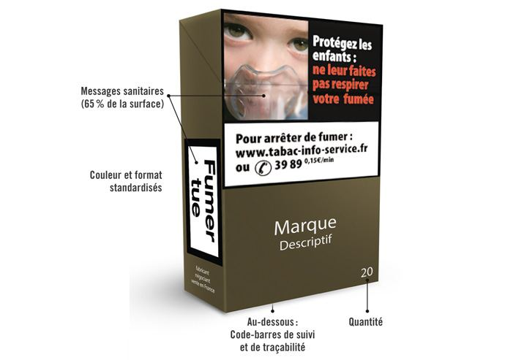
Generals in the French context
Neutral packaging
Increased tobacco price
Reimbursement by the Health Insurance of Nicotine Substitutes Therapy (NST)
Initially limited to a package of 100 €, now uncapped
National and local campaign to help people quit smoking, renewed every year in November, "Tobacco-Free Month"

Slide 4

Effects of tobacco on the oral sphere
The effects of tobacco on the oral sphere are multiple: dental stains, lesions of the oral mucosa or oral cancers. Loss of taste and smell, salivary decrease and halitosis
Proven risk factor for periodontitis. Aggravates their severity, prevalence and evolution. Risk of developing periodontitis is 4 X higher for a heavy smoker than for a moderate smoker
Surgery : Tobacco will impact post-extraction healing (oxygenation, poor clot stability, less bone healing)
Implantology : Tobacco delays healing. It does not prevent pre-implant (GBR, sinus lift ...) and implant surgeries but reduces the success rate by 13%
Tobacco is a common factor in 80-90% of patients with upper aerodigestive tract cancer

Slide 5
Evolution of the environment for the Dentist
Support of a health professional increases the chances of a successful withdrawal process by 50 to 70%!
In 2007, the UFSBD decided to mobilize the profession to change the framework of intervention of the Dentist.
Dentist can screen, and refer to an addictologist
Since 2016, the profession has been one of the new prescribers of NST. This new skill makes it possible to act in the first line with patients
Reimbursement of Dentist’s prescriptions
2019, 3,529 Dentist prescribed NST; they were 2,095 in 2018 and 871 in 2017

Slide 6




A guide to take action
with the participation of

Slide 7
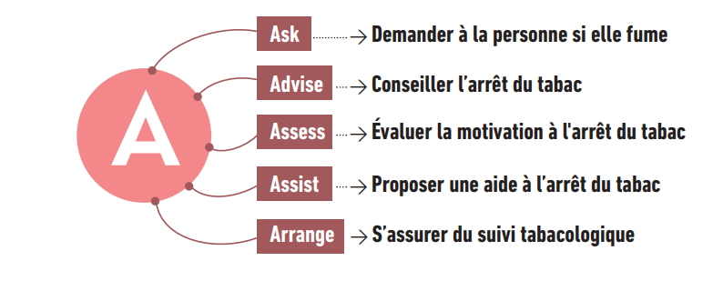
Identify and Advise
Patients in good general health repeatedly consult a dentist more often than a general practitioner well placed to identify their smoking patients and advise them on quitting .
Brought to see their patients several times to treat them accompany and support them in the long term.

Slide 8
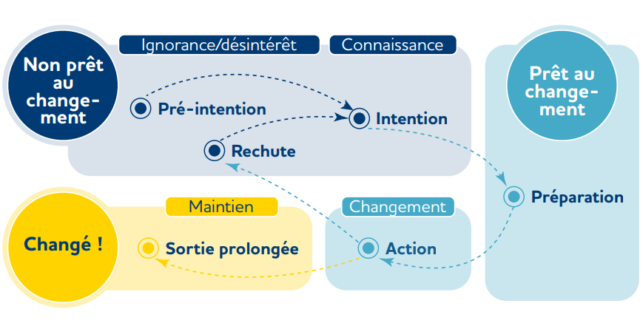
Behaviour change

Slide 9

Prevent and educate: minimal action
STAGE 1 = PRE-INTENTION
"QUITTING SMOKING, NO, I DON'T WANT TO!"
Patient does not feel concerned about quitting smoking, he does not plan to quit smoking
Without the patient's motivation, any attempt to quit smoking will be doomed to failure
The role of the dentist is then to inform the patient of the impact of tobacco on his general health, and more specifically on the oral sphere.
You have to be able to arouse his interest, make him adhere to this approach, "I can help you if you wish"

Slide 10
Prevent and educate: minimal action
STAGE 2 = INTENT
"I'D LIKE TO QUIT SMOKING BUT IT'S NOT THAT SIMPLE.“
Patient is considering to quit smoking, but his current motivation has not yet led him to start the weaning process.
The role of the dentist is to explore the patient's ambivalence ("I know I should quit smoking, I would like to, but I can’t”)
Degree of motivation on a scale of 0 to 10 (0 no motivation, 10 very strong motivation)
Weak motivation: do not insist, discuss with the patient the benefits at the stop. Revisit the problem at a future consultation and strengthen motivation at every opportunity
Average motivation: removing obstacles and reassuring the patient in order to strengthen his motivation;
Strong motivation: stage 3. Encourage people to start weaning

Slide 11

Detect, inform, assess addiction (physical, psychological, behavioral)
STAGE 3 = PREPARATION
Patient is ready to start smoking cessation.
The practitioner must then assess the difficulty of withdrawal to determine if he feels competent to manage smoking cessation or if he prefers to refer the patient.

Slide 12
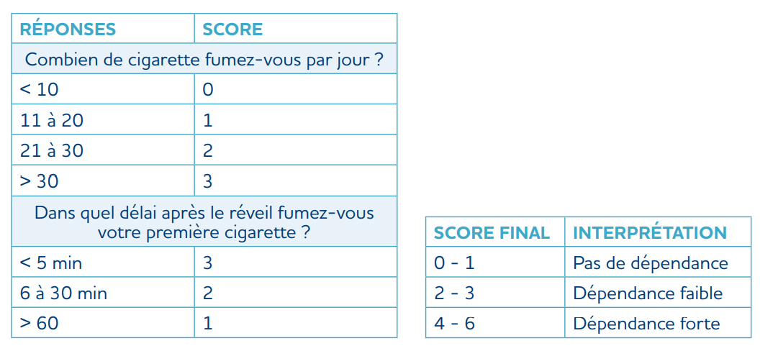
Detect, inform, assess addiction (physical, psychological, behavioral)
Difficulty of weaning depends on:
  Support, patient's entourage, the existence of codependencies (alcohol, drugs) or anxious or depressive comorbidities that accentuate the intensity of withdrawal symptoms;
  Patient's level of dependence, which is easy to assess using the Fagerström test. It consists of six questions but can be simplified in daily practice to two main questions
  The practitioner will have to determine the appropriate action plan to accompany the patient in his weaning, in particular by agreeing on a stop date

Slide 13

STAGE 4 = ACCOMPANY THE PATIENT IN WEANING
NICOTINE SUBSTITUTES (NST)
Since 2016, dentists have been able to prescribe nicotine substitutes from the age of 15. Effective way to lead to abstinence, increasing withdrawal success by 50-70% in the long term.
The effectiveness can be increased with techniques such as cognitive behavioural therapy and motivational interviewing.
Nicotine substitutes are available in the form of:
extended release: patch / patch allowing a slow and constant nicotine intake;
Rapid release: chewing gum, sucking tablets/lozenges, inhaler and mouth spray
Dosage: empirical rule : manufactured cigarette = 1 mg of nicotine absorbed. At start, prescribe an amount equivalent to 100% of the dose of nicotine normally smoked by the patient

Slide 14
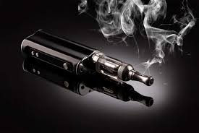
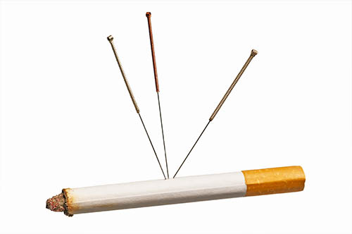
ALTERNATIVE METHODS: ELECTRONIC CIGARETTE, BEHAVIORAL TECHNIQUES
Electronic cigarette: If a smoker refuses the recommended nicotine replacement means, the use of the electronic cigarette should not be discouraged but should be part of a quitting strategy with accompaniment. It should be noted that in vitro and in vivo studies showed adverse effects on periodontal tissues
Acupuncture: Studies on the subject appear to show short-term interest in smoking cessation but there is no unbiased evidence showing efficacy in smoking abstinence at six months.

Slide 15
ALTERNATIVE METHODS: ELECTRONIC CIGARETTE, BEHAVIORAL TECHNIQUES
Hypnosis: very great heterogeneity in studies to conclude on the contribution of hypnosis during withdrawal. There may be beneficial interest in the absence of other treatments with recognized efficacy (NST). Due to the lack of harmfulness of acupuncture and hypnosis, the patient is free to experiment with them if he expresses the wish.

Slide 16
Framework to set the dental surgeon as a full actor
Mobilization of institutions on the possible dentist role
Reimbursement of nicotine substitutes
Dentist Training
Right to prescription of nicotine substitutes
It takes 10 to 12 years to reform the health system

Slide 17
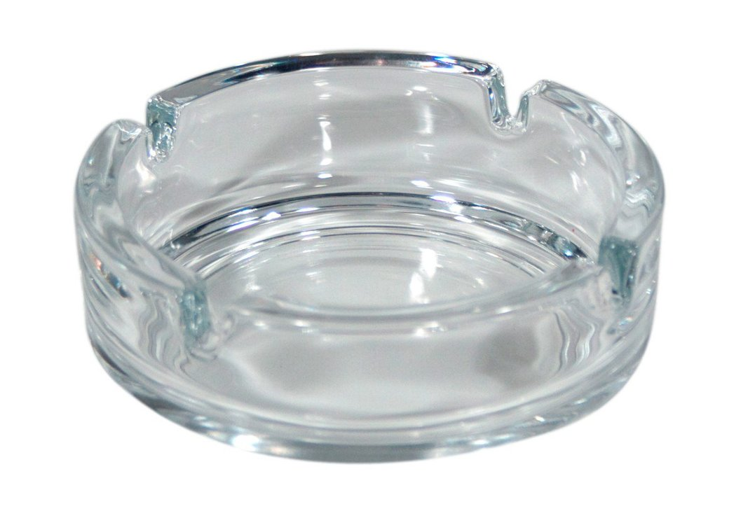
Any questions?
Thank you for your attention

