Slide 1

Role of Oral Health Professionals in Tobacco Control
Dr. Sharad Kapoor

Slide 2
Learning Objectives
Importance of health professional.
Ways to contribute in tobacco cessation approaches and control
Knowledge assessment

Slide 3
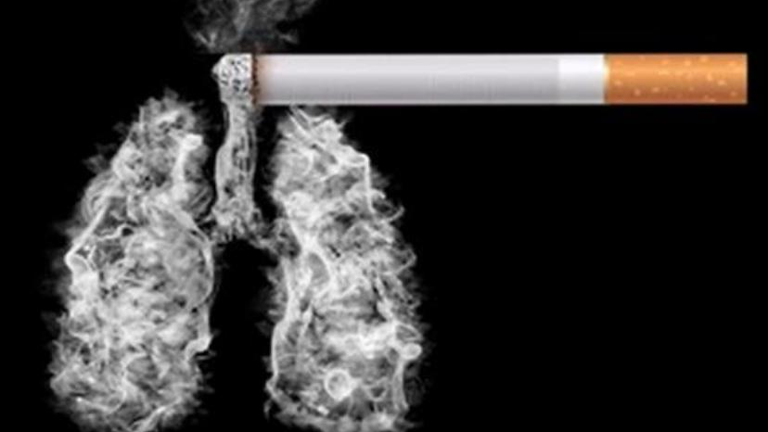
Tobacco
The tobacco plant, Nicotiana, has probably been responsible for more deaths than any other herb.
It has been estimated that there are 1.1 billion smokers worldwide and 182 million (16.6%) of them live in India.
It has been predicted by the World Health Organization (WHO) that more than 500 million people alive today will be killed by tobacco by 2030 and tobacco consumption will become the single leading cause of death.

Slide 4
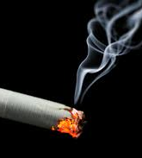
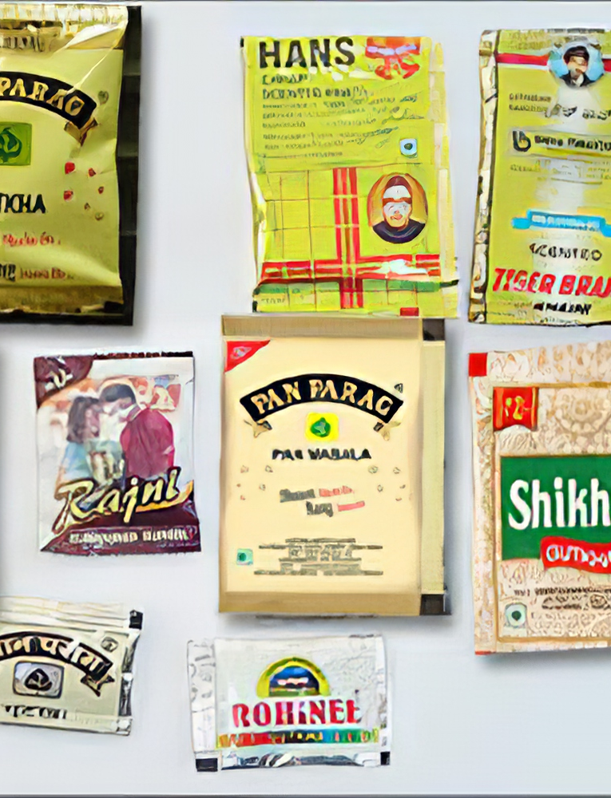
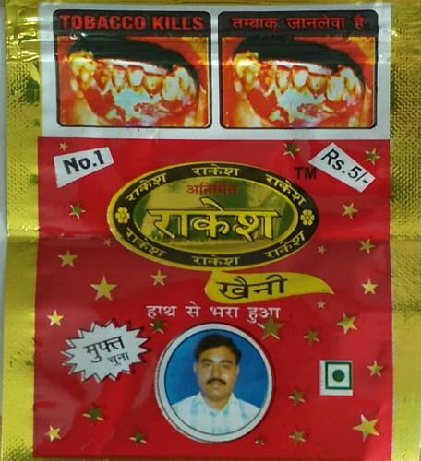
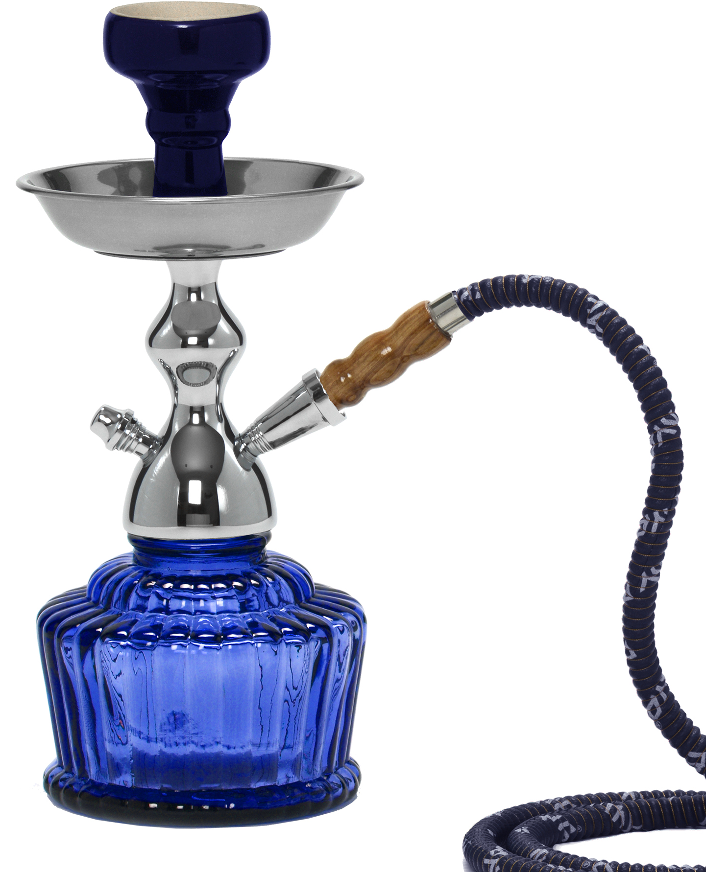

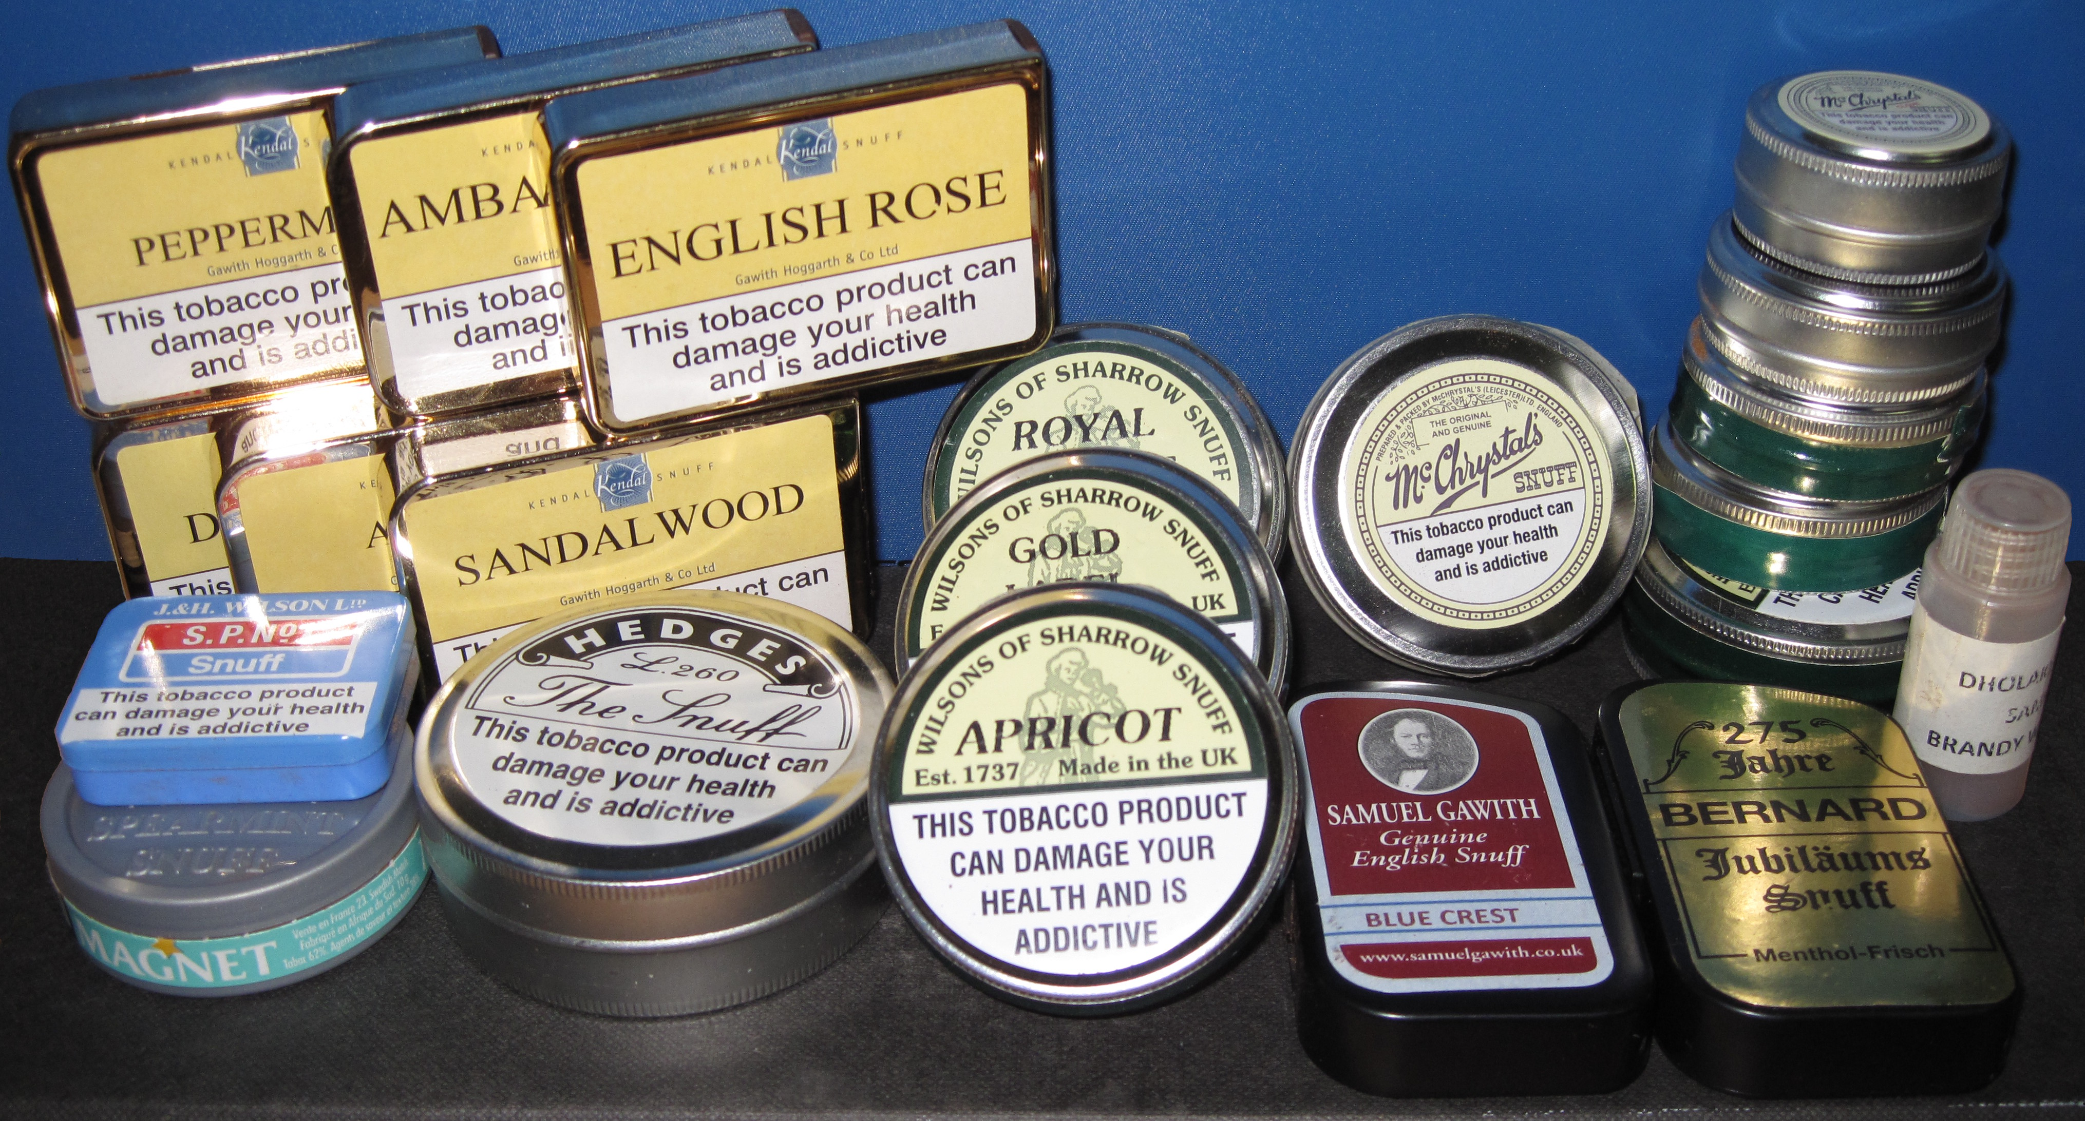
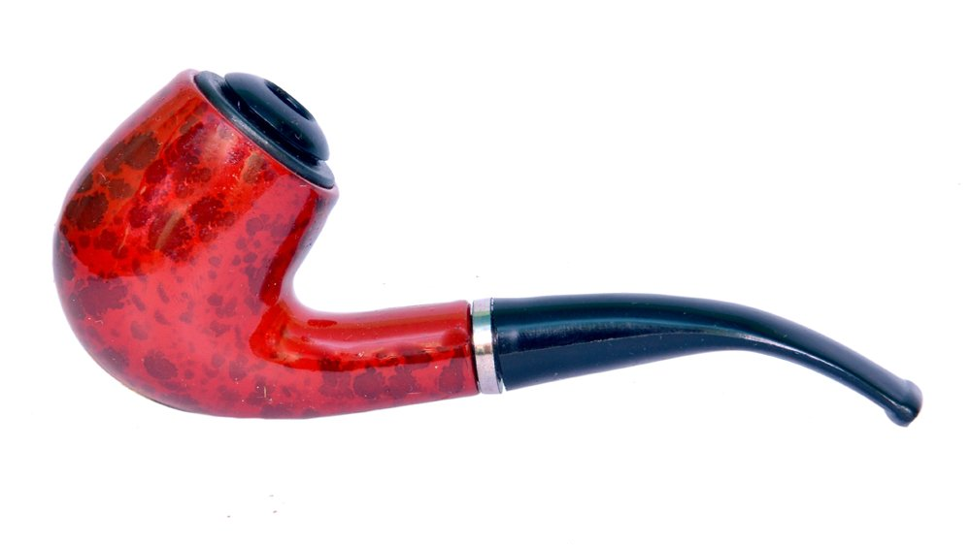
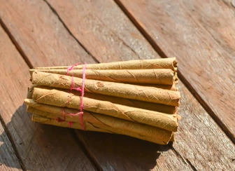
Modes of use
Smokable
Chewable

Slide 5
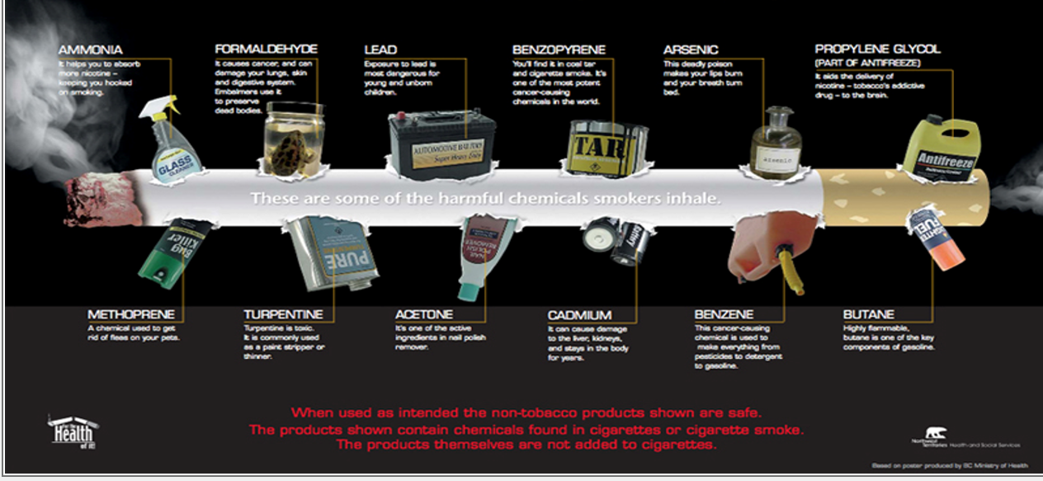
Hidden Danger- More than 4000 chemicals in cigarettes and cigarette smoke

Slide 6
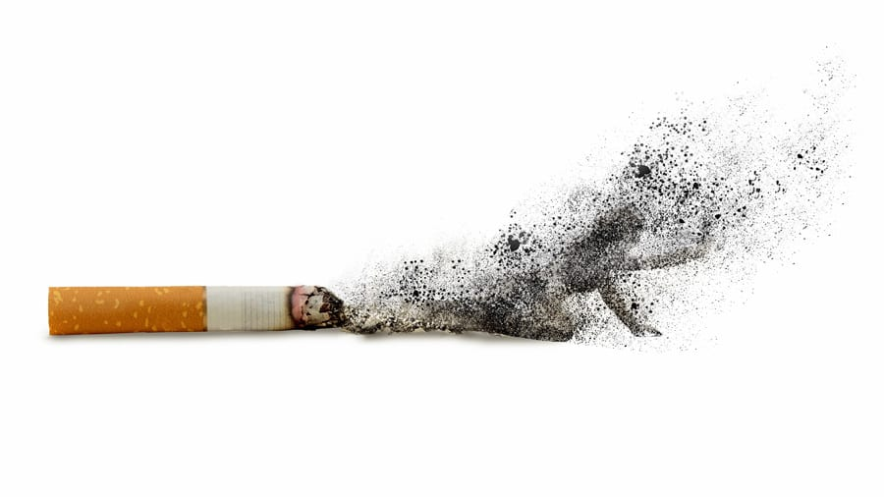
Health consequences of tobacco use

Slide 7
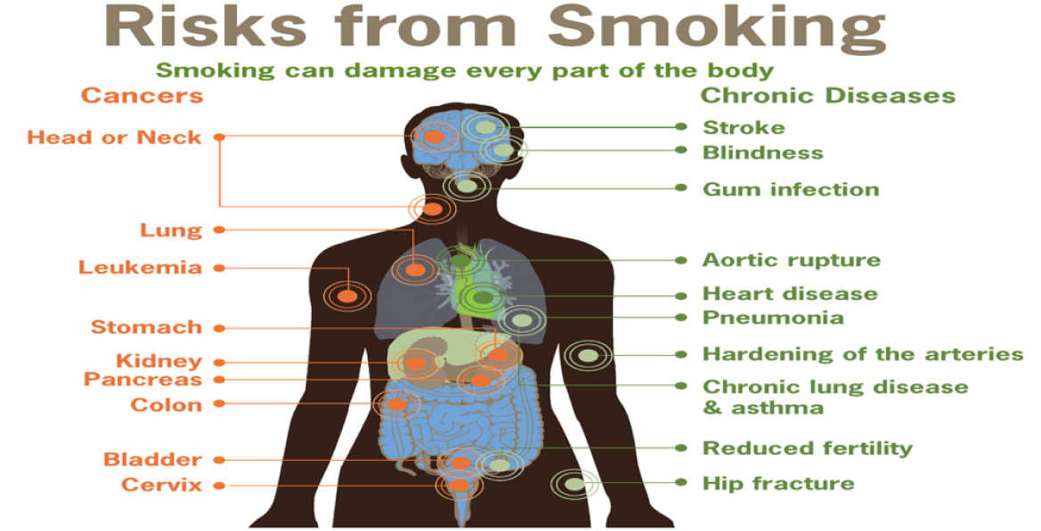

Slide 8

HEALTH CONSEQUENCES OF TOBACCO USE
Precancerous lesion
Precancerous condition
OSMF
Leukoplakia
Erythroplakia
Smoker’s Palate
Cancerous condition
Squamous cell carcinoma
Lichen Planus

Slide 9
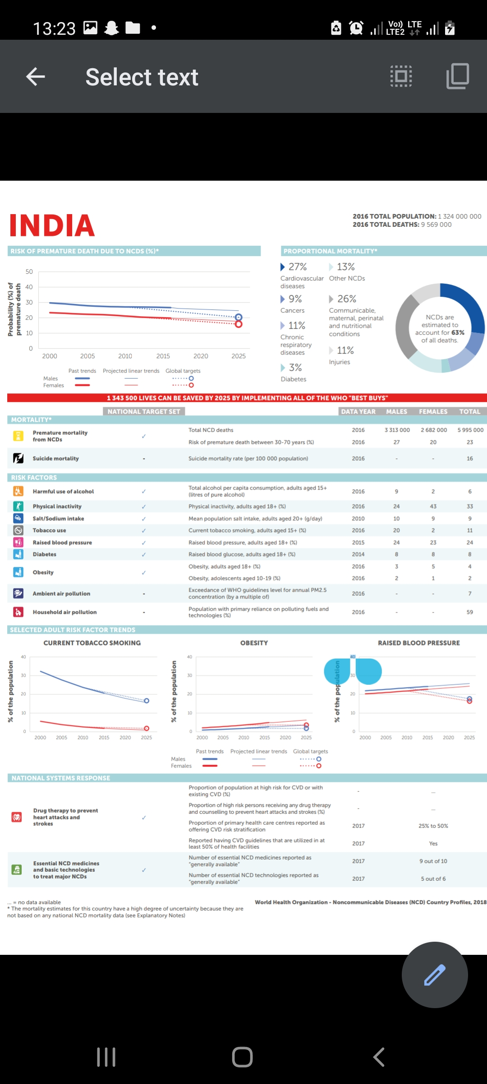

Slide 11

Role of Healthcare professionals

Slide 12
The 5A approach
Ask
Advise
Assess
Assist
Arrange

Slide 13
The 5R’s model
Relevance
Risks
Rewards
Roadblocks
Repetition

Slide 14
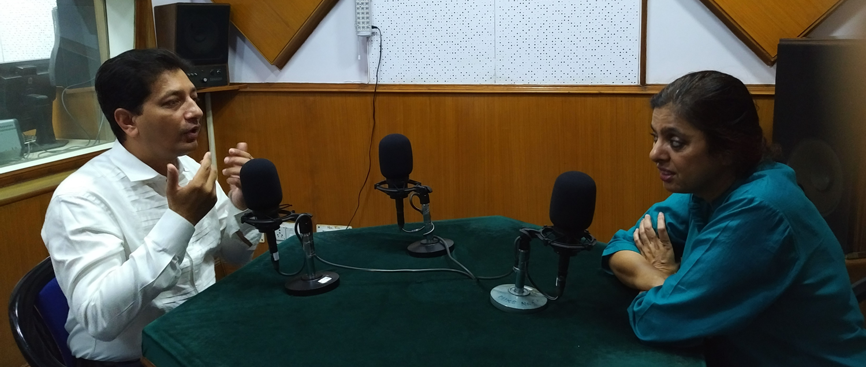
Discuss stopping tobacco use in public programs of media

Slide 15
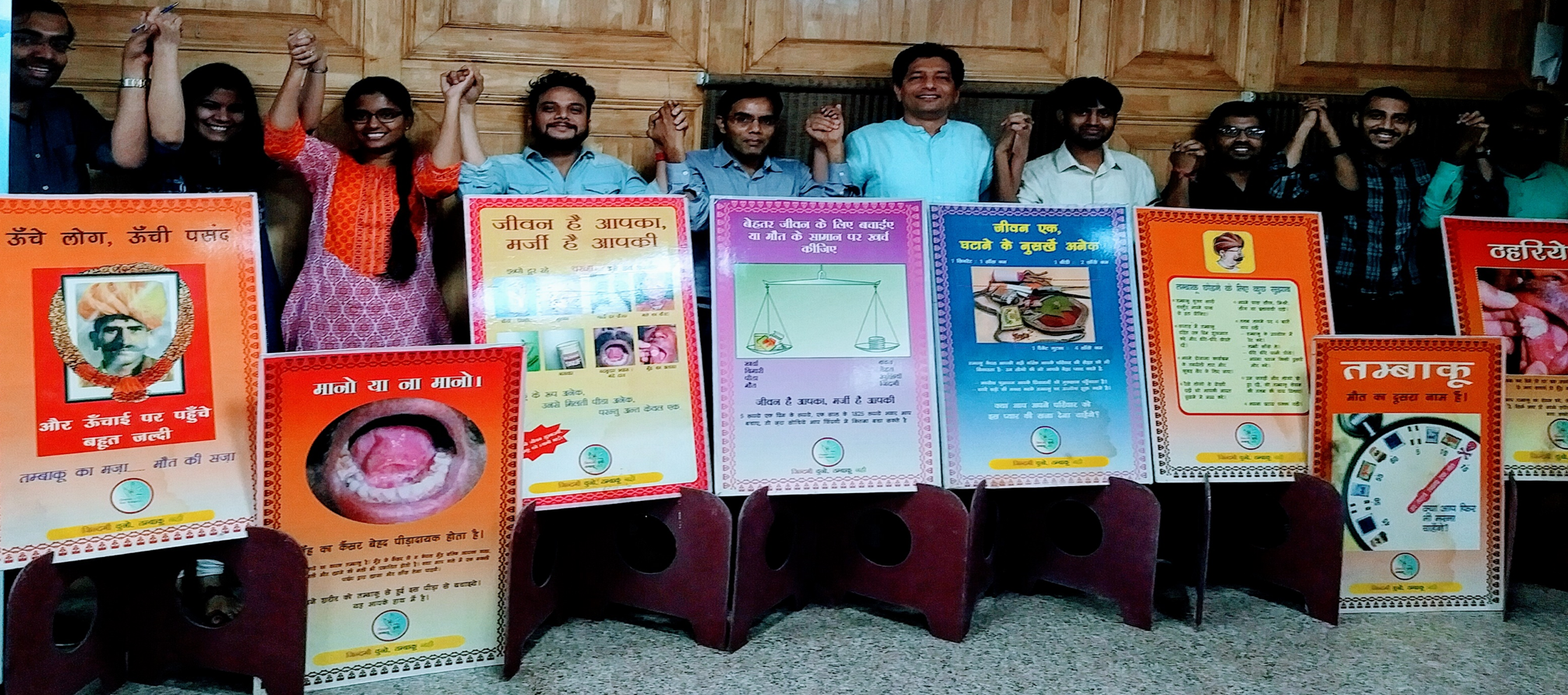
Healthcare professionals joining hands

Slide 16
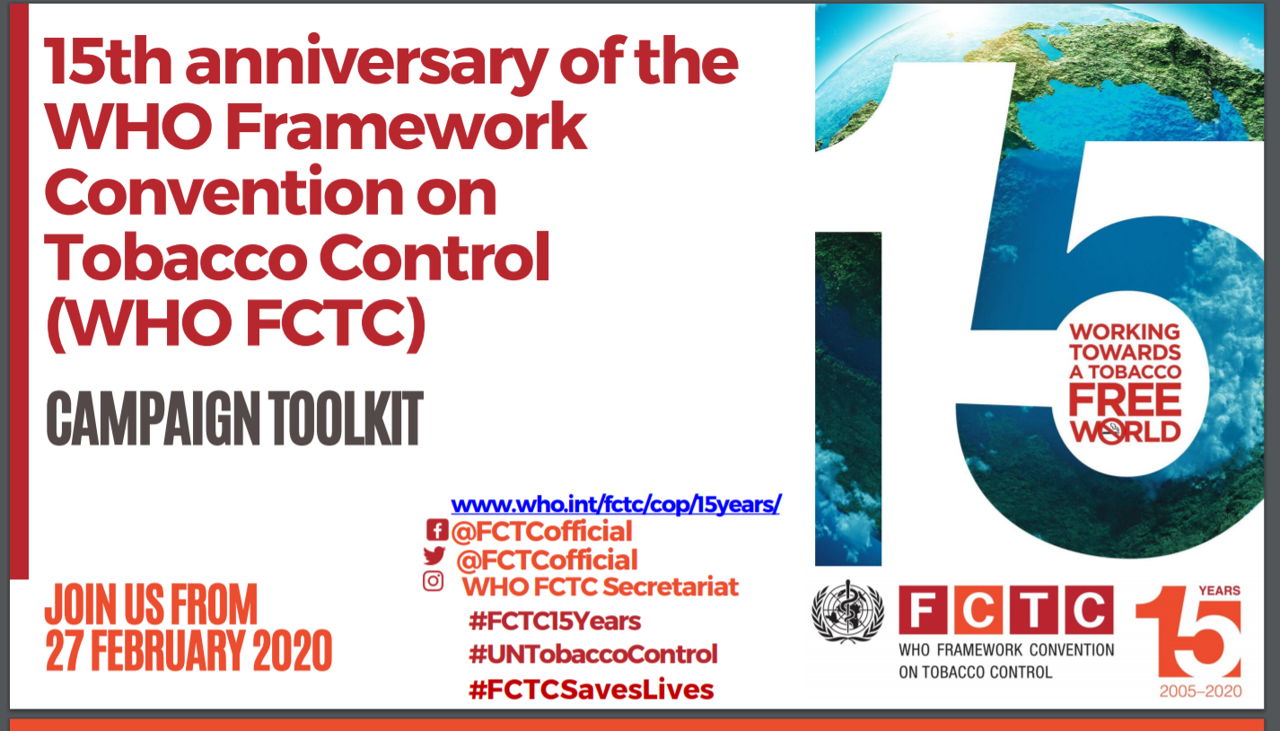
Health Professionals Against Tobacco
(Support the WHO FCTC)

Slide 17

WHO response
2003
In 2003, WHO Member States unanimously adopted the WHO Framework Convention on Tobacco Control (WHO FCTC).
2005
In force since 2005, it has currently 182 Parties covering more than 90% of the world’s population.
2007
In 2007, WHO introduced a practical, cost-effective way to scale up implementation of the main demand reduction provisions of the WHO FCTC on the ground: MPOWER.

Slide 18
M
Monitor tobacco use and prevention policies
P
Protect people from tobacco use
0
W
E
R
Offer help to quit tobacco use
Warn about the dangers of tobacco
Enforce bans on tobacco advertising, promotion and sponsorship
Raise taxes on tobacco
6 MPOWER MEASURES

Slide 19
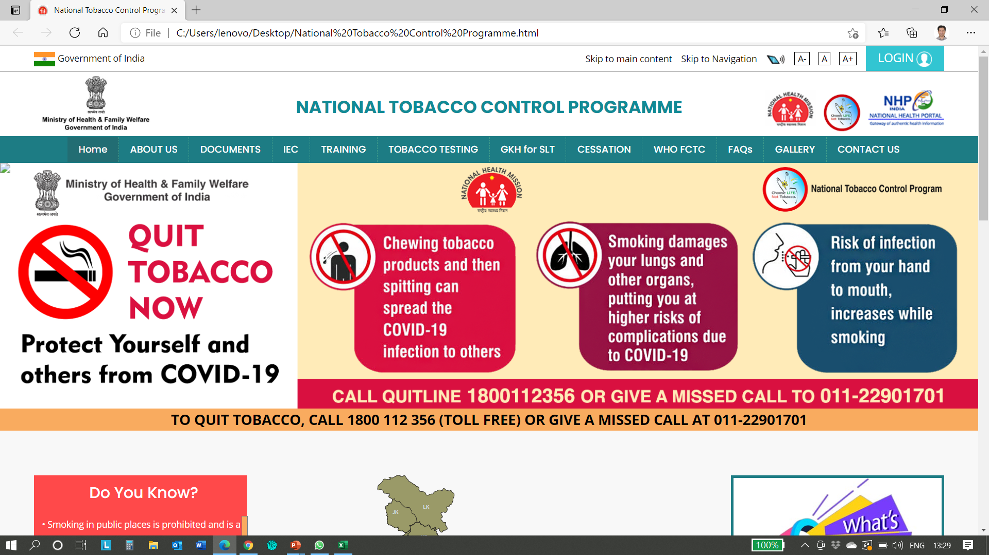
Supporting the policies and programmes

Slide 20
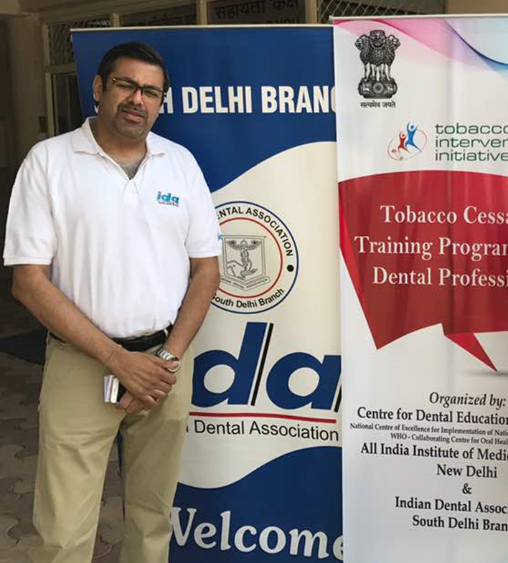

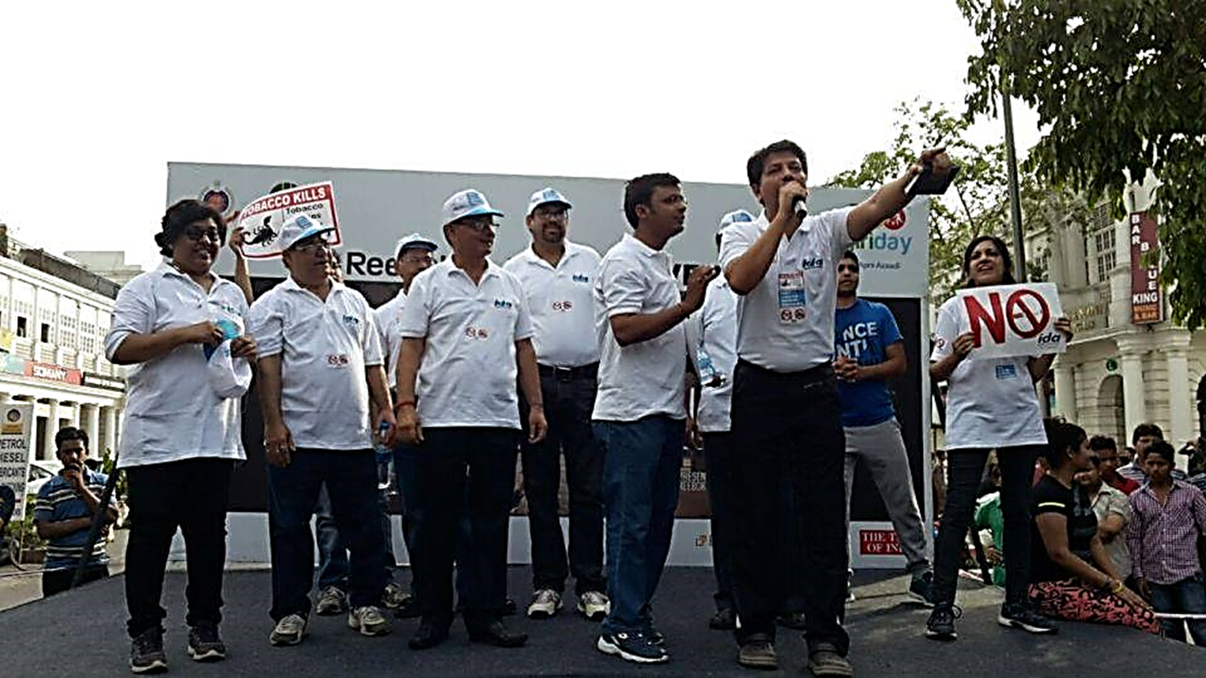
Professional Associations
Play A Major Role

Slide 21
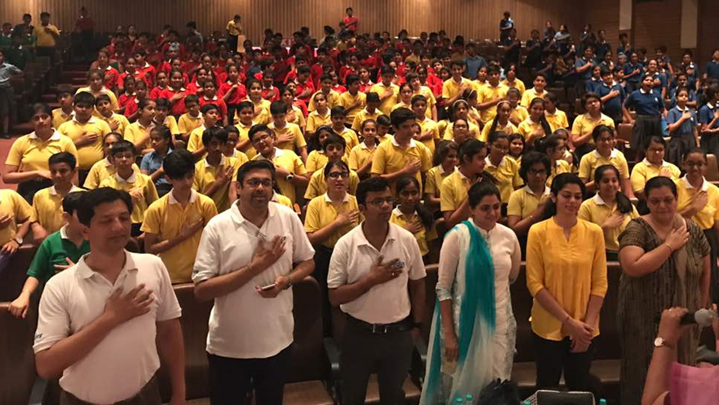
Catch them young, make children aware about harms of tobacco

Slide 22

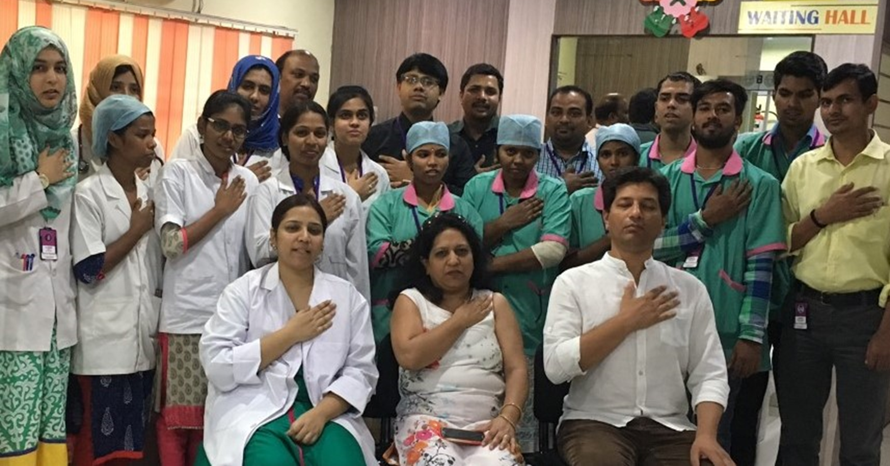

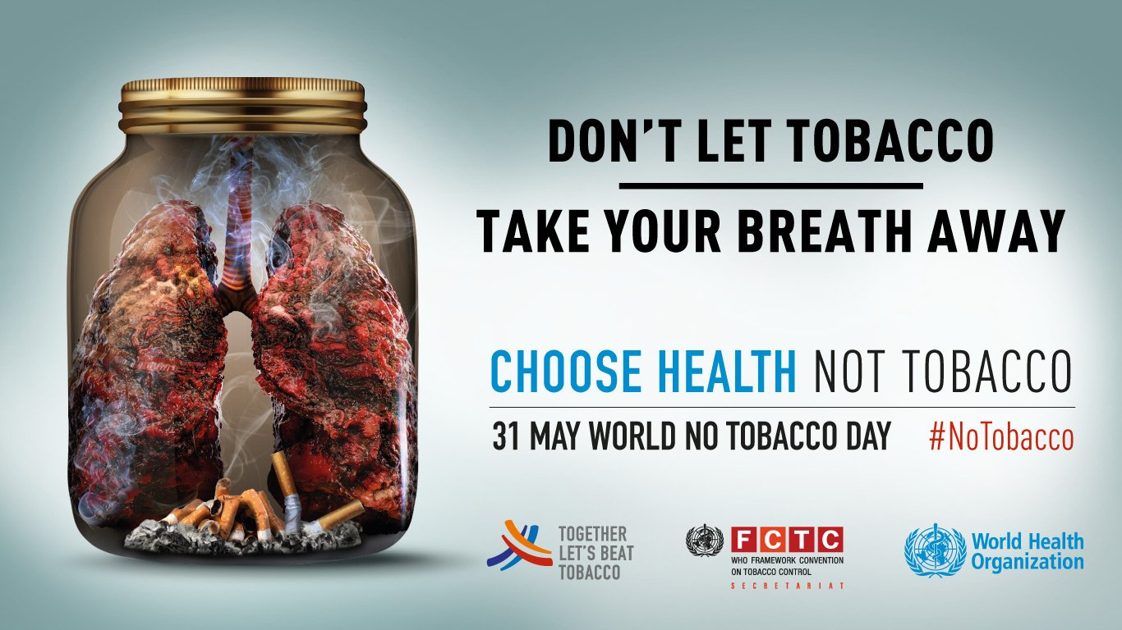
Celebrate
World No Tobacco Day

Slide 23
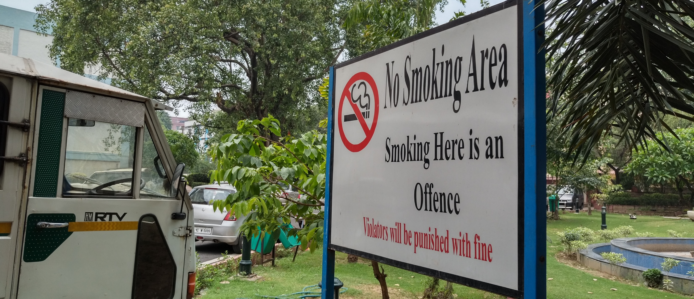
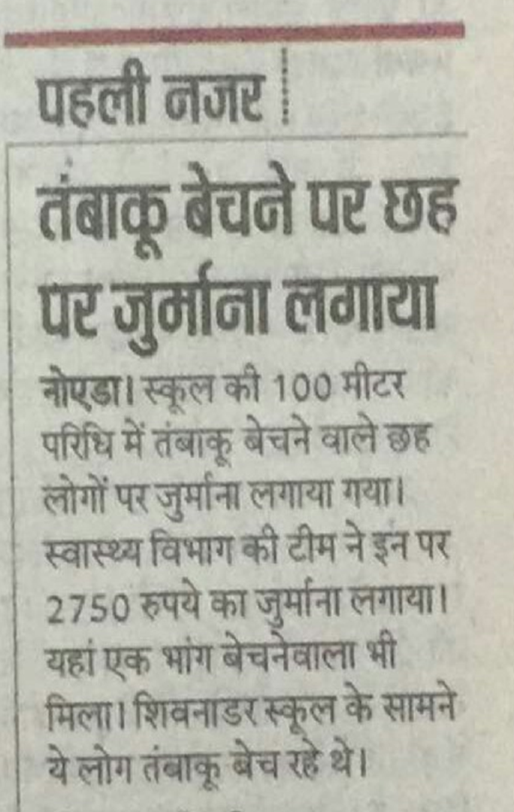
Support smoke-free public places

Slide 24

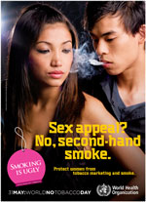

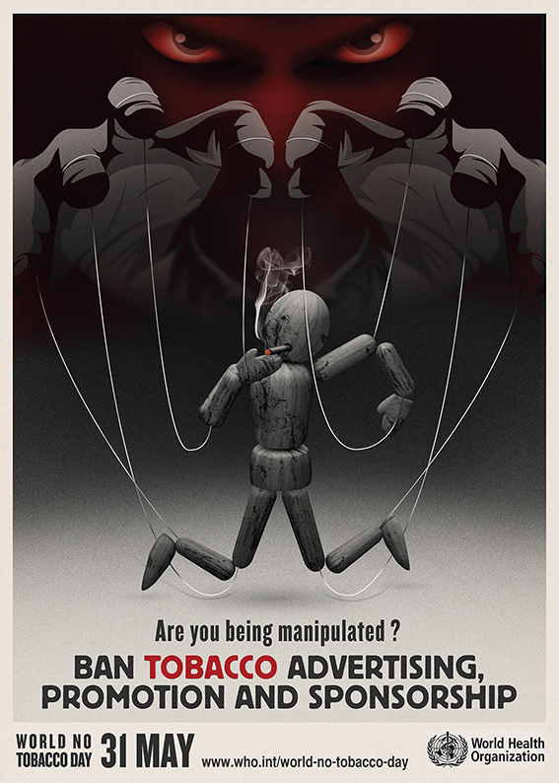
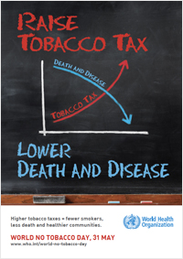
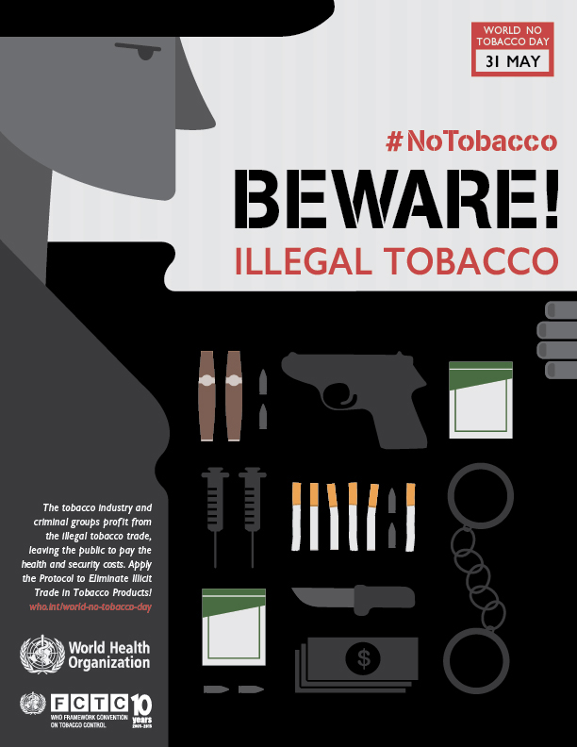

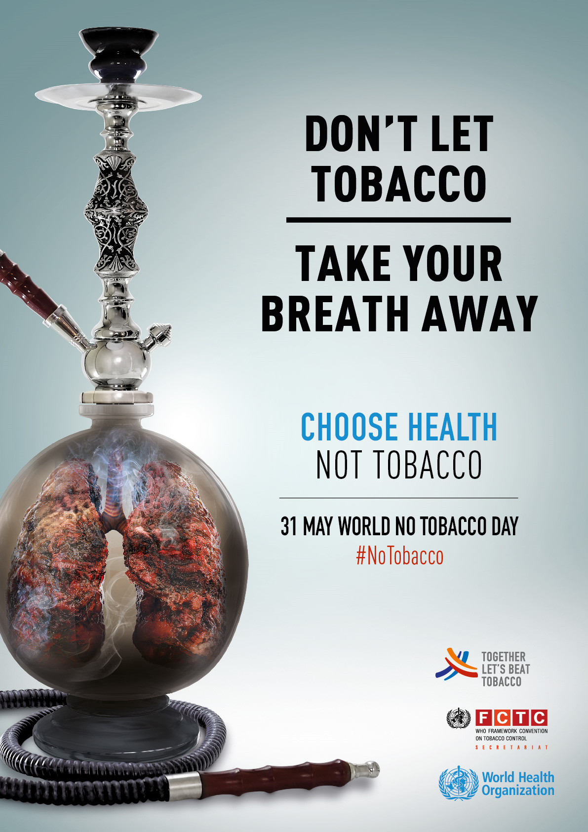
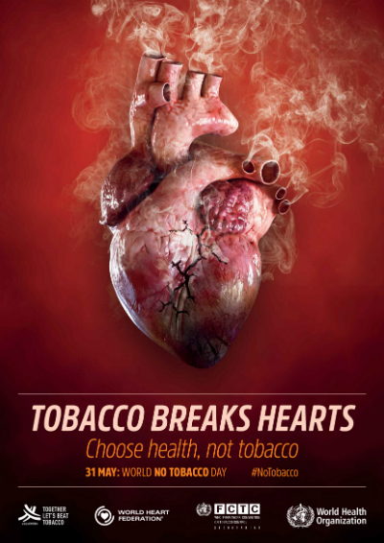

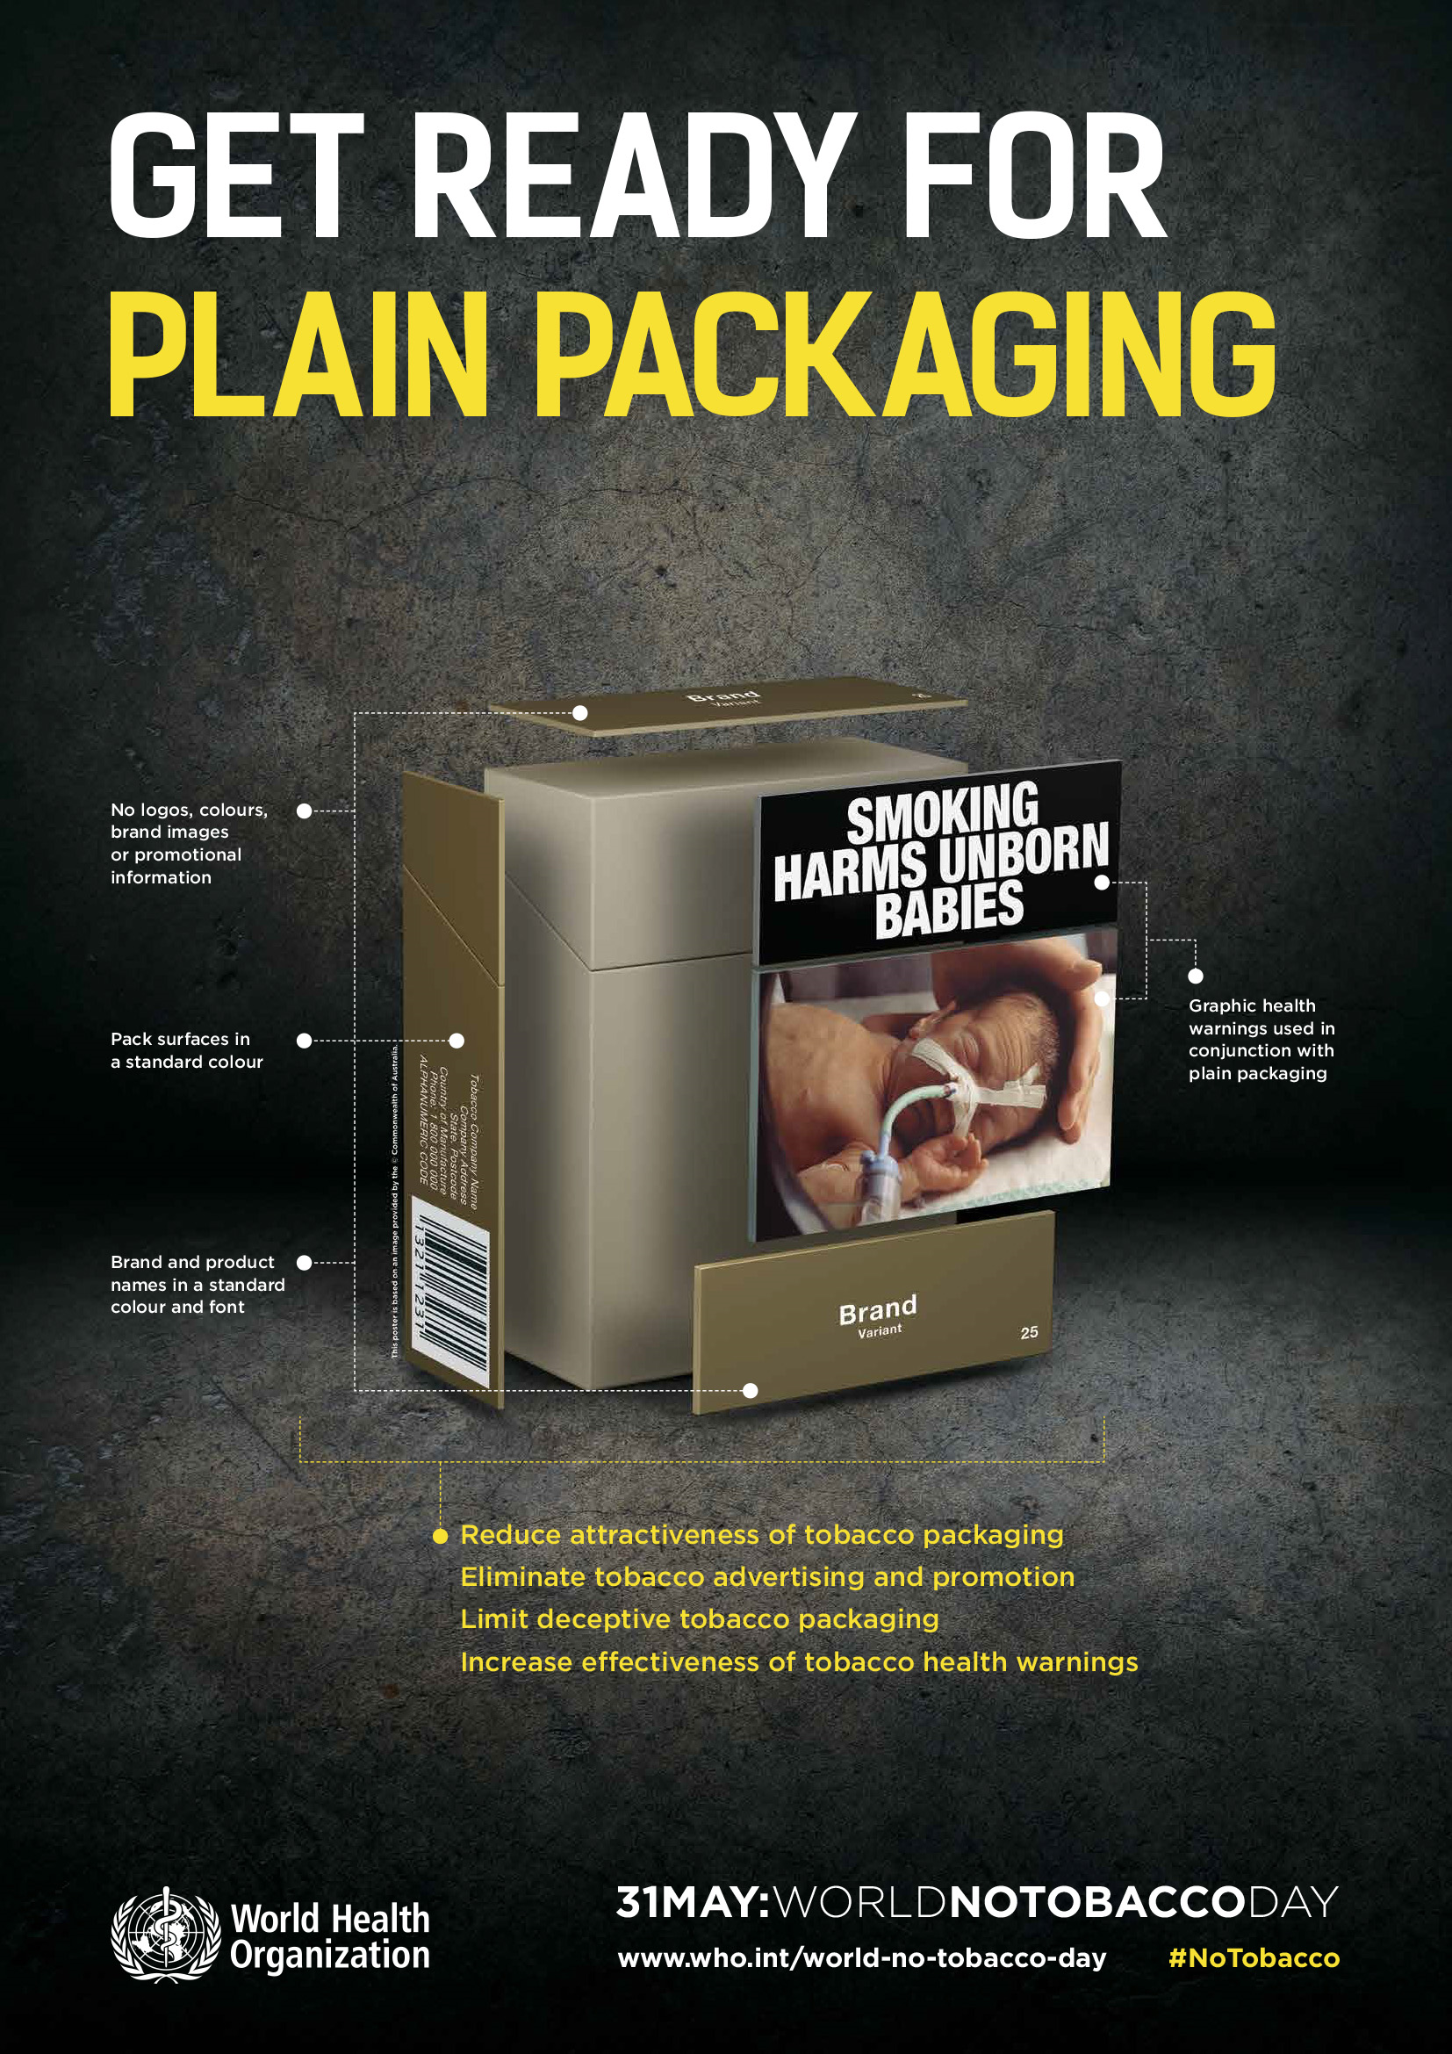

Slide 25
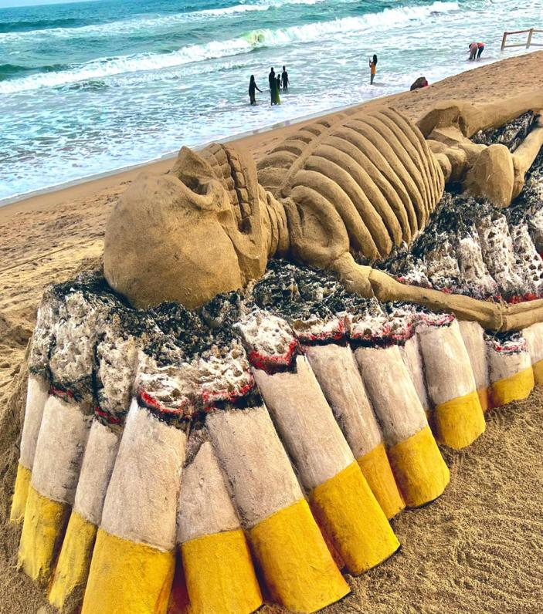
SAY NO TO TOBACCO!

Slide 26

Thank YOU!

